Slide 1
STRING Stakeholders meeting
Staff exchange in Alsace
Bologna, 15 October 2018

Slide 2
ALSACE: FOOD SECTOR OVERVIEW
food-processing industry
Big groups (Kronenbourg, Mars, etc), cooperatives, SMEs (family owned, third generation).
ARIA: Association Régionale des Industries Alimentaires d'Alsace. ARIA is a private association. 20 SMEs in the board, 6 vice-presidents. SMEs pay an annual fee and part of the costs of specific services of programmes (see NOVIAA). It is mainly self-financed.
In 2009 regional government decided to support research in “old” industrial sectors (food and metallurgy), that are the backbone of the Alsatian economy, because French government decided to financially support the “new” industries (IT, etc). This led ARIA to start a cooperation with local research centres.
INDICATORS | SOURCE | AGRICULTURE | FOOD PROCESSING
Number of firms | Agriculture : AGRESTE (2013)¹ Food Processing: Observatoire agroalimentaire Alsace 2015 (2014) | 10 849 | 424
Production Volume: turnover (mln €) | Agriculture : AGRESTE (2013)² Food Processing : AGRESTE (2010)³ | 1 294 | 5 600
Number of employees (‘000) | Agriculture : AGRESTE (2013)¹ Food Processing: Observatoire agroalimentaire Alsace 2015 (2014) | 18.7 | 14.4
Value added (mln€) | Agriculture : AGRESTE (2013)² | 545 | 1 000
VA per employee | Food Processing: Observatoire agroalimentaire Alsace 2015 (2012) | 29 144€ | 74 739€

Slide 3
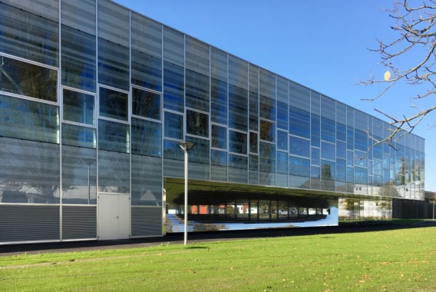
Alsace Biovalley: AERIAL & EASE
Aérial- Technology Resources Centre and Technical Institute for Food Industry
AERIAL is a Research and technological centre, active on food innovative technologies and applied research,but it acts also as start-up incubator.
Nutritional audits (For example with cured sausages)
Sensorial and organoleptic analysis (Consumer panels)
Research programmes (Food for Mars)
EASE European Aseptic and Sterile Environment training center
EASE is a 4300 mq factory-school for training in sterile processes for pharmaceutical, cosmetic and agro-food industries. It is a CRT, 30% public funded 70% private, 60% are international clients.

Slide 4
NOVIAA
The NOVIAA programme has been developed by ARIA Alsace for its members, to foster innovation.
NOVIAA is a collective training in innovation. Industries are supported for a year by one or more expert(s) to develop an innovation strategy that can be replicated afterwards. Aside this customised support, they also have the opportunity to meet other companies during conference sessions.
It is a training and support programme, with a collective and an individual dimension.
The approach is multi-disciplinary and appeals to thematic experts.
NOVIAA costs 145 000€ a year for 15 enterprises participating and 6 experts. It is financed by the Region Grand Est (30% of the total cost) and the French State (29 000€ in 2016).
The cost for an enterprise, after theses subventions, is around 6000€ (the price is reviewed every year) and it can be financed by the national financing bodies for training (OPCA).

Slide 5
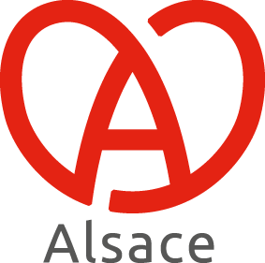
SAVOUREZ L’ALSACE
Developed in 2013, Savourez l’Alsace is a collective trade brand made to identify quality products processed in Alsace, by Alsatian food industries.
Savourez l’Alsace® is a territorial brand of more than 2500 products from 50 different food companies, in accordance with specifications.
The aim of creating a collective brand is to improve business for food industries.

