Slide 1
Seminario 2° bando modulare MED
Bologna– 08/02/2017
Curzio Cervelli
Programme co-financed by the European Regional Development Fund
Programme cofinancé par le Fonds européen de développement régional

Slide 2
Programme Architecture
3rd level impact Mediterranean SHARED VISION on policies & actions
MODULAR projects
1st level impact
Local results
HORIZONTAL projects
2nd level impact
Thematic transnational
communities
2
HP Green Growth
Facilitation
1
2/3
3
Innovation
HP Blue Growth
Results
1/2
1/2/3
HP Social & Creative
exchanges
2
Facilitation
1
2/3
HP Efficient Buildings
3
Low-carbon
economy
Axis 4 – platform
Results
1/2
HP Urban Transport
1/2/3
HP Renewable Energy
exchanges
2
HP Sustainable Tourism
Facilitation
1
2/3
Natural
and cultural
Resources
3
HP Biodiversity Protection
Results
1/2
1/2/3

Slide 3
Axis 4 – overview
WORK PACKAGE 1
Methodologies & Evaluation
Applied to
WORK PACKAGE 2
Strategic Theme Costal and maritime tourism
LIAISING
WORK PACKAGE 5
MANAGEMENT
Cross cutting TASKS
MIGRATION
WORK PACKAGE 3
Strategic Theme Maritime surveillance
MAINSTREAMING
Functional to
WORK PACKAGE 4
COMMUNICATION

Slide 4
1st modular and 1st horizontal calls State of the art

Slide 5
Interreg MED Modular 1st call (Submission Nov.2015)
Final figures
Submitted projects > 375
Eligible projects | 339 | Total eligible: 90,4%
APPROVED through 2 steps of assesment: 61
Axis 1 | 16 (out of 53 in 2nd step) | Total approved: 16,2% of 375 submitted
Axis 2 | 22 (out of 42 in 2nd step)
Axis 3 | 23 (out of 46 in 2nd step)

Slide 6
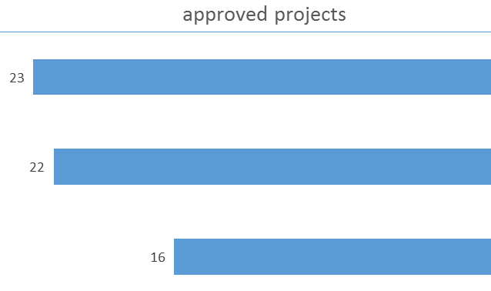
Interreg MED Modular 1st call (Nov.2015)
61 modular projects approved (16,2% of 375 submitted)
axis 3
axis 2
axis 1

Slide 7
1st call total approved projects per S.O.
Total participation:
ERDF > 549
IPA > 23
Green Growth
Blue Growth
Social & Creative
Urban Transport
6 projects
16 projects
Renewable Energy
6 projects
Biodiversity Protection
9 projects
Efficient Buildings
10 projects
Sustainable Tourism
14 projects

Slide 8
Approved projects – Axis 1
M1
M1+2
M2
M2+3
M3
HP SYNGGI
Green Growth
ARISTOIL
GREENOMED
CAMARG
MADRE
GRASPINNO
PEFMED
HP InnoBlueGrowth
Blue Growth
MAESTRALE
PROteuS
PELAGOS
iBLUE
HP TALIA
Social & Creative
COWORKMed
open DOORS
ChIMERA
Prominent MED
CreativeWear
Co-Create

Slide 9
Approved projects – Axis 2
M1
M2
M2+3
M3
HP MEDNICE
Efficient Buildings
PRIORITEE
TEESCHOOLS
NEW FINANCE
SISMA
IMPULSE
STEPPING
ENERJ
EduFootprint
SHERPA
CESBA MED
HP GREENCAP
Renewable Energy
PEGASUS
PRISMI
ForBioEnergy
StoRES
LOCAL4GREEN
COMPOSE
HP GO SUMP
Urban Transport
CAMP-sUmp
SUMPORT
LOCATIONS
MOBILITAS
REMEDIO
MOTIVATE

Slide 10
Approved projects – Axis 3
M1
M1+2
M2
M2+3
HP BleuTourMed_C3
Sustainable Tourism
ShapeTourism
SIROCCO
MEDFEST
EMbleMatiC
BLUEISLANDS
CO-EVOLVE
BLUEMED
CASTWATER
TOURISMED
MEDCYCLETOUR
MITOMED+
DestiMED ALTER ECO
CONSUME-LESS
HP PANACeA
Biodiversity Protection
ACT4LITTER
WETNET
MPA-ADAPT
EcoSUSTAIN
FishMPABlue 2
ConFish
POSBEMED
AMAre
MEDSEALITTER
For the moment, no capitalisation projects

Slide 11
Interreg MED Horizontal 1st call Submission Jan.2016
Some figures
Submitted projects > 14
Eligible projects | 13
Approved projects 1st step (pre candidature) > 11
Approved projects 2nd STEP (full candidature):
Axis 1 | 3 (out of 5)
Axis 2 | 3 (out of 3)
Axis 3 | 2 (out of 3)
Total of approved projects proposed to the SC : 8 (72,7%)

Slide 12
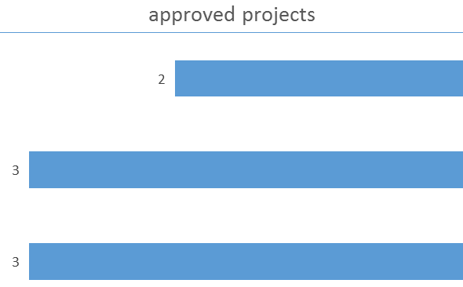
Interreg MED Horizontal 1st call (Nov.2015)
8 horizontal projects approved (72,7% of 14 submitted)
axis 3
axis 2
axis 1

Slide 13
Total ERDF/IPA Programmed
Modular (September + December) & Horizontal (September)
 | ERDF |  |  | IPA
 | September | December | Total | September | December | Total
Axis 1 | 25 015 769,00 | 6 095 202,96 | 31 110 971,96 | 448 190,99 | 260 397,50 | 708 588,49
Axis 2 | 31 830 251,39 | 7 359 027,49 | 39 189 278,88 | 1 142 990,93 | 458 957,50 | 1 601 948,43
Axis 3 | 35 996 351,88 | 6 556 804,78 | 42 553 156,66 | 683 288,23 | 98 897,50 | 782 185,73
Total | 92 842 372,27 | 20 011 035,23 | 112 853 407,50 | 2 274 470,15 | 818 252,50 | 3 092 722,65
61 Modular projects
8 Horizontal projects
69 approved
projects
112,9 M€ ERDF
3,1 M€ IPA

Slide 14
ERDF/IPA Programming rate
 | ERDF |  |  | IPA
 | CP | Programmed | % | CP | Programmed | %
Axe 1 | 71 783 208,00 | 31 110 971,96 | 43% | 2 619 619,00 | 708 588,49 | 27%
Axe 2 | 44 864 505,00 | 39 189 278,88 | 87% | 1 871 158,00 | 1 601 948,43 | 86%
Axe 3 | 76 269 660,00 | 42 553 156,66 | 56% | 3 180 966,00 | 782 185,73 | 25%
Total | 192 917 373,00 | 112 853 407,50 | 58% | 7 671 743,00 | 3 092 722,65 | 40%
ERDF/IPA remaining budget
 | ERDF | IPA
Axe 1 | 40 672 236,04 | 1 911 030,51
Axe 2 | 5 675 226,12 | 269 209,57
Axe 3 | 33 716 503,34 | 2 398 780,27
Total | 80 063 965,50 | 4 579 020,35

Slide 15
GENERAL EXPECTATIONS

Slide 16
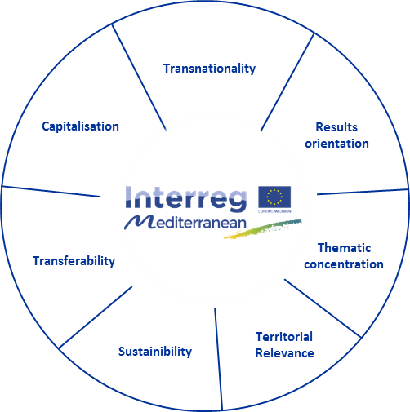
Key principles of INTERREG MED Programme
More info: see Programme Manual of INTERREG MED Programme: www.interreg-med.eu

Slide 17
Quality and excellence of projects
Effective answer to common challenges
TERRITORIAL Cooperation
Sharing expertise
Motivate real and positive changes
Think on final beneficiaries
Coherence between working plan and associated budget.
Realistic budget
Risk management in project implementation
Effective and USEFUL evaluation

Slide 18
Capitalisation 2.0
Existing MED projects, results and initiatives
Library of deliverables
Projects databases
With other INTERREG Programmes and projects
E.g. INTERREG IV C Capitalisation platforms
Central Europe
ADRION Programme
KEEP Database
With other initiatives at European, National and sub-national levels
European: EIB, Horizon2020, LIFE Programme
National: Slovenian strategies of innovation, energy, tourism.
Sub-national: regional and local regulation, policies, plans.

Slide 19
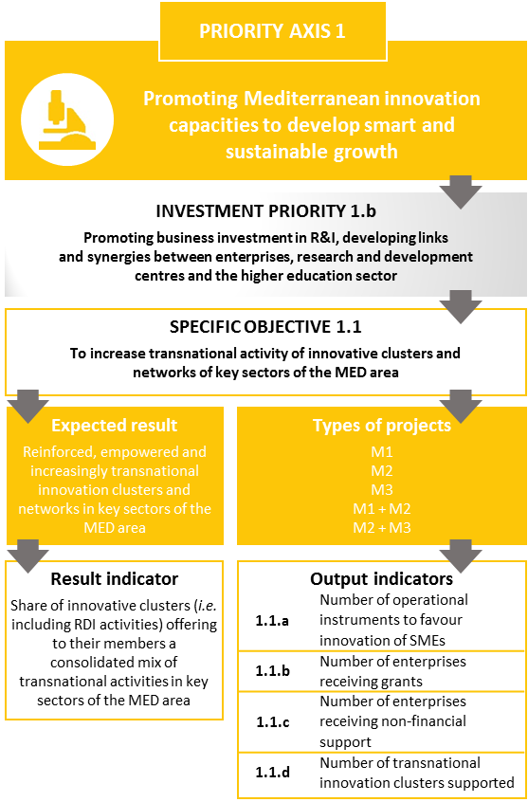
Intervention Logic (Matching Programme-Project expectations)

Slide 20
2nd call for modular projects
AXIS 1 INNOVATION
Blue Growth fishing & aquaculture, biotechnologies, coastal and maritime tourism
Green Growth in particular, smart cities
Creative and Cultural Industries
Social Innovation in particular, social entrepreneurship
NOT OPENED TO SINGLE MODULE PROJECTS
AXIS 3 ENVIRONMENT
3.1 Coastal and Maritime Sustainable Tourism
Focus on concrete implementation at large scale of ICZM and MSP principles and systematization of use of existing tools to monitor the sustainability of tourism in the area.
3.2 Management and networking of protected areas
Focus on better integration of protected areas in regional development strategies and more intensive cooperation and networking between Interreg MED regions.
AXIS 2 LOW CARBON ECONOMY
The available budget after the first call; The coverage of all themes mentioned in the ToR; The existing critical mass, reinforced from the previous programming period;

Slide 21
INTEGRATED projects
AXIS 1 INNOVATION
Blue Growth
Green Growth
Creative and Cultural Industries + Social Innovation
AXIS 3 ENVIRONMENT
3.1 Coastal and Maritime Sustainable Tourism
3.2 Management and networking of protected areas
AXIS 2 LOW CARBON ECONOMY
1 PROJECT ON S.O. 2.3. - Increase capacity to use existing low carbon transport systems and multimodal connections among them.
1 PROJECT PER THEME
1 PROJECT PER THEME

Slide 22
 | M2 | M3 | M1+2+3
Blue growth | X | X | X
Green growth | X | X | X
Cultural and creative industries + Social Innovation | X | X | X
Efficient buildings
Renewable energy
Urban transport |  |  | X
Sustainable tourism |  | X | X
Biodiversity protection | X | X | X

Slide 23
INTEGRATED PROJECTS EXPECTATIONS

Slide 24
What to stress for a good pre-application ? (1)
A previous desk research:
(ETC and/or thematic EU programmes)
To avoid overlapping
To avoid waste money
To support on going projects
To better « integrate »

Slide 25
What to stress for a good pre-application ? (2)
A strong partnership:
Geographically balanced
Matching project objectives with partnership skills
Mixing institutional and operational roles
Thinking, enabling and supporting transfer
Ensuring capitalisation
Strong policy vision

Slide 26
What to stress for a good pre-application? (3)
A transnational vision:
(inside and outside your territories)
1 project
1 specific objective (or sub theme)
1 single area > Mediterranean

Slide 27
What to stress for a good pre-application ? (4)
A clear operational objective:
Understandable
Measurable
Reachable
Transferable

Slide 28
What to stress for a good pre-application ? (5)
A realistic budget:
For partners: competencies and roles

Slide 29
What to stress for a good pre-application ? (6)
A coherent project timeline per module

Slide 30
Integrated Projects (Key issues)
Problems faced and solutions proposed will cut across the Mediterranean
Focus on issues of high relevance for the area, taking into account previous work carried out at local level, of which results could be brought on a transnational scale
Modules are built in a logical sequence, as real inputs for the following activities and not in separate way/overlapping
The partnership is based on multi-level actors: strong local partners/networks (research centers, associations, universities, local authorities, enterprises, chambers of commerce etc.)
Core partners: Regions and state organisms

Slide 31
2nd Call for Modular projects

Slide 32
The Modular approach
The modules :
Module 1: STUDYING: designing common approaches & strategies at TN
Module 2: TESTING: Pilot demonstration actions
Module 3: CAPITALISING: Transfer, dissemination and capitalisation.
The modular projects:
The horizontal projects:
community building,
joint communication,
joint capitalisation/transfer
Single Modules.
Combination of Modules.
Focus on synergies mechanisms, thematic communities

Slide 33
2nd Call for modular projects
Single Module Projects (M2/M3)
Integrated Projects (M1+M2+M3)

Slide 34
Single-module
 | M2 Testing | M3 Capitalising
Expected outputs (non exhaustive) | Preliminary & feasibility studies Pilot activities Evaluation Plan of transferability of results | Policy recommendations MoU / Agreements Procedures and regulatory proposals Charters Protocols
Duration | 30 months | 18 months
Budget | 1.2 – 2.5 M € | 0.6 – 1.2 M €
Partnership | Max 10 PP: operational and institutional partners | Max 8 PP: mainly institutional or networks partners

Slide 35
Multi-module
 | M1+M2+M3 Integrated Projects
Expected outputs (non exhaustive) | SWOT analysis, State of the art, Benchmarking analysis, Models, Action plans, Strategies, Instruments Preliminary & feasibility studies, Pilot activities, Evaluation, Plan of transferability of results Policy recommendations, MoU, Agreements, Procedures & regulatory proposals, Charters, Protocols
Duration | 48 months (M1: 15-m / M2: 21 m / M3: 12 m)
Budget | 3.6 – 6 M €
Partnership | Max 15 PP: institutional, operational and scientific partners and networks

Slide 36
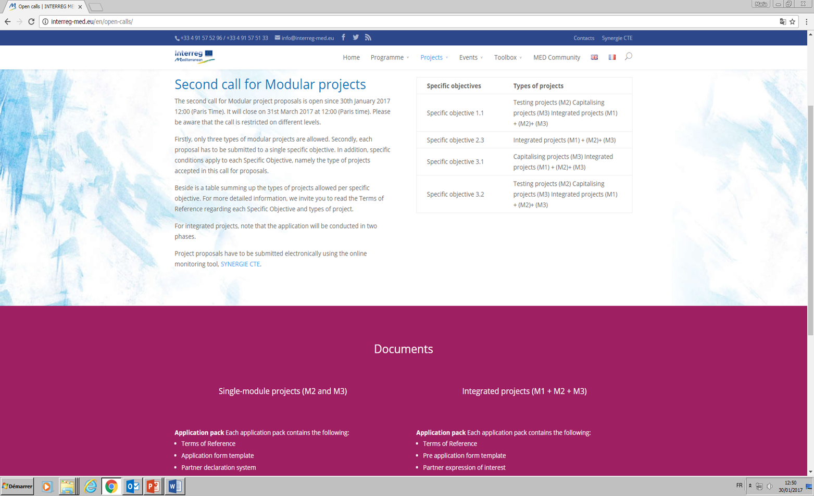
Key documents on: www.interreg-med.eu
The Terms of Reference (specific for single module projects and for integrated projects)
Interreg MED Programme Manual (incl. Synergie guide for application)
Interreg MED Glossary
F.A.Q.
The Forum (for partner search and exchange)
Interreg MED Cooperation programme (CP)
Interreg MED SWOT analysis
MED 2007-2013 project Library
Other documents/tools of interest listed in the ToRs
These documents remain essential for the applicants

Slide 37
RULES AND PROCEDURES

Slide 38
ELIGIBILITY OF PARTNERS
 | ERDF partners | IPA partners | Lead Partner
National, regional and local public bodies | X | X | X
Public equivalent bodies (bodies governed by public law as defined in Article 2(1) of Directive 2014/24/EU) | X | X | X
Private institutions | X | Only non profit private institutions
International organisations | X
IPA partners and ERDF partners outside of the MED area cannot act as Lead Partners

Slide 39
EU (ERDF) partners outside the MED area
Added value and expertise to the implementation
Benefit for the MED area
20% of the ERDF budget of the operation
Confirmation of eligibility before approval
Agreement between MED MA and the relevant EU country after approval
In case of failure, the concerned partner could be excluded from the project.

Slide 40
PRIVATE PARTNERS
Private partners can co-finance with their own funds
Private structures can not act as Lead Partners
Private bodies have to observe the basic principles on public procurement laws
Bodies whose main scope of activities within their business profile, as well as their project role, consists of project coordination or management, or other activities that are of a mere executive or supporting character (service providers) cannot be involved as project partners.
Please refer to each ToR for further details on the expected private participation

Slide 41
PARTNERSHIP – MINIMUM REQUIREMENTS
As a minimum requirement, the partnership must involve:
at least 4 financing partners
from at least 4 different countries from the MED area
with at least 3 of the partners located in the Union part of the MED area = 3 ERDF partners within the MED area
Additional recommendations on the most suitable partnership size according to each type of project are included in each ToR.

Slide 42
PARTNERSHIP REQUIREMENTS
The LP of pre-application and final application must be the same
A partner in a horizontal project cannot participate in a modular project approved within the same specific objective. National Ministries and Regional authorities can be exempted from this rule, if for particular reasons their participation to a horizontal project is requested (to be justified in the application form).

Slide 43
Associated partners
Shall not receive any ERDF or IPA funds
No budget
Only possible expenditures: Travel and accommodation expenditures to be borne and claimed by a financing partner
Cannot act as service provider
Coming from EU, IPA and third countries
Associated partner declaration to be signed

Slide 44
LOCATION OF THE ACTIVITIES
Project activities should take place in the MED area.
Activities outside of MED area MAY be accepted IF they are :
for the benefit of the Programme area;
essential for the implementation of the project;
explicitly foreseen in the Application Form or, previously authorised by the MA/JS.

Slide 45
STATE AID
The decision on which instrument to apply is to be made by the applicants themselves considering carefully the implications
Art.20 of GBER aims a simplification of administrative burden for SMEs within Interreg projects
 | General Block Exemption Regulation (GBER) – Art. 20 | De minimis rule
Maximum public contribution (ERDF grant) | Up to EUR 2 million per SME and per project | Up to EUR 200 000 over a period of 3 fiscal years
Co-financing rate | Up to 50% | Up to 85%
Undertakings concerned | Only SMEs | Undertakings in all sectors
Application phase | Partner Declaration | Partner declaration + de minimis declaration

Slide 46
HOW TO APPLY (I)
SINGLE MODULE
1/ Create a lead partner account on SYNERGIE CTE
2/ Fill in the application form on SYNERGIE CTE
Before starting Lead partner must choose :
the specific objective
the type of project to be submitted
Guidance on how to fill in the form will be provided.
The application form has to be drafted in English or French
Section summary is requested in both English AND French
Indicative starting date: 1st December 2017

Slide 47
HOW TO APPLY (II)
SINGLE MODULE
3/ Request the additional documents to partners; signed and stamped – compulsory annexes
Partner declaration dated, signed & stamped = all partners
“De minimis” declaration dated, signed & stamped = partners State Aid relevant
Associated partner declaration dated, signed & stamped = associated partners
No other type of document and no modification to the standard documents provided by the Programme will be accepted.

Slide 48
HOW TO APPLY (III)
SINGLE MODULE
4/ Validate the content of the application form on SYNERGIE CTE (1st deadline)
Once the application form is entirely filled in, the Lead Partner must validate it by pressing the VALIDATION button.
A single confirmation e-mail is automatically sent when the validation has been performed correctly.
By 31st of March 2017 at noon – 12.00 (Paris time)

Slide 49
HOW TO APPLY (IV)
SINGLE MODULE
5/ Upload compulsory annexes through SYNERGIE CTE (2nd deadline)
Partner declaration all partners
“De minimis” declaration partners State Aid relevant
Associated partner declaration associated partners
Confirmation page “Submitted” of the AF– dated, signed and stamped
Each document shall be scanned and uploaded by the LP individually.
The upload of the compulsory annexes can be done during the completion of the application form.
Any document shall not exceed the size of 8 MB.
by 14th of April 2017 at noon – 12.00 (Paris time)
6/ Gather and keep the paper version of the signed documents

Slide 50
HOW TO APPLY (I)
1/ SEND AN E-MAIL TO THE JS
Access to the Synergie CTE system will be granted solely and exclusively upon request by e-mail sent to the following address: programme_med@regionpaca.fr
Object of the e-mail: “Synergie CTE – creation of a proposal of an integrated project”
Information requested:
Name of the applicant organization / institution
(if the organization is already registered on the CTE Synergy database, it will be enough to indicate the known ASP number)
Tax code or registration code of the organization used at the national level
Contact person
Project Axis and Specific Objective
Project Acronym
Do not wait the last minute!!
Applications for opening of accounts for “integrated” modular projects
will be guaranteed until the 15th March 2017
TIP

Slide 51
HOW TO APPLY (II)
2/ VALIDATE THE LEAD PARTNER ACCOUNT
Active your account using the activation link sent by e-mail (by SYNERGIE CTE)
3/ ACCESS TO THE SYSTEM
After the activation of the account LP will be allowed to enter the system, work on the Pre-application Form and upload the compulsory annexes at any time until the submission deadlines
Do not leave things to the last minute!!
Last day for the submission is usually very busy for the system and it could slow down.
Any problem in submitting the proposal or uploading the documents not caused directly by SYNERGIE CTE will not be considered.
TIP

Slide 52
APPLICATION IN 2 PHASES
1st phase
2nd phase
Pre-application
January 30th 2017
March 31th, 2017
ONLY through SYNERGIE
Full Application Form
Beginning of June 2017*
End of July 2017*
Compulsory annexes to be uploaded (14 April 2017):
Pre-application form confirmation page
Partners expressions of interest
Compulsory annexes:
Application form confirmation page
Partners declarations
“De minimis” declarations
Eligibility + Assessment + Negociation
(*indicative)

Slide 53
Calendar
Single modular projects
Integrated projects
Official presentation : 22 February 2017 (Barcelone)
Opening of the Call: 30th January 2017
Closing of the call: Closing of the Call:
1st deadline: Validation of the application form by: 31st of March 2017 at noon – 12:00 (Paris time)
2nd deadline: Upload of compulsory annexes by: 14th of April at noon – 12.00 (Paris time)
Evaluation (2 assessment phases): 1st semester 2017
Expected starting of the projects:
December 2017
Official presentation : 22 February 2017 (Barcelone)
Application in 2 phases:
Pre-application phase: Jan 30 – Mar 31
Evaluation and negotiation: May – June (indicative)
Full-application phase: June -July 2017 (indicative)
Projects expected to start: December 2017

Slide 54
ADMINISTRATIVE AND ELIGIBILITY CHECK
List of administrative and eligibility criteria included in the Factsheet Appraisal of project proposals (eligibility and assessment criteria) of the Programme Manual
Proposals failing in any of the criterion will be regarded as non-eligible and eliminated.
MAIN ELIGIBILITY PROBLEMS IN THE PAST
Application form not validated correctly on Synergie CTE (A.1)
Compulsory annexes are missing; not duly filled in; signed or stamped (A.2)
LP located outside of the MED EU area (B.2)
Wrong amount of the national co-financing included in the partner declarations (B.3)

Slide 55
Contact details per Specific Objective
Specific objective 1.1
Maria Groueva
mgroueva@regionpaca.fr
Nuno Vaz Silva
ncvazsilva@regionpaca.fr
Specific objectives 2.1 & 2.3
Roberta Lixia
rlixia@regionpaca.fr
Specific objective 2.1 & 2.2
Nicolas Garnier
ngarnier@regionpaca.fr
Specific objective 3.1
Sophie Scarvelis
sscarvelis@regionpaca.fr
Specific objective 3.2
Francesca Marcato
fmarcato@regionpaca.fr
More info: http://www.interreg-med.eu/

Slide 56
FINANCIAL ASPECTS

Slide 57
AVAILABLE BUDGET & CO-FINANCING RATE
SINGLE MODULE
The total ERDF funds foreseen for the single module projects is approximately 30 M€
The total IPA funds foreseen for the single module projects is approximately 1,2 M€
ERDF and IPA co-financing remain at 85%
Total eligible budget for M2 projects is between 1.2 – 2.5 M €
Total eligible budget for M3 projects is between 0.6 – 1.2 M €
Co-financing:
ERDF & IPA partners 85%
Private partners (GBER) 50%

Slide 58
AVAILABLE BUDGET & CO-FINANCING RATE
The total ERDF funds foreseen for the integrated projects is approximately 35 M€
The total IPA funds foreseen for the integrated projects is approximately 1,4 M€
ERDF and IPA co-financing remain at 85%
Total eligible budget for an integrated project will be between 3.6 M€ - 6 M €
Co-financing:
ERDF & IPA partners 85%
Private partners (GBER) 50%

Slide 59
Principles for a good budget proposal
Horizontal principles
Economy + Efficiency + Effectiveness
Budget to be agreed with the rest of your partnership
M2 or M3:
Full application : detailled information and detailed budget per partner structured per budget line and work-package
Shall reflect the work plan, i.e. outputs, activities and deliverables planned in order to achieve the intended results
Integrated projects:
Pre application phase : partner level ONLY (ERDF/IPA + national contribution)
In proportion with partners participation in the different Work packages
Try to anticipate the details by work packages, b.lines and deliverables

Slide 60
MAIN NOVELTIES ON ELIGIBILITY OF EXPENDITURE
Simplified costs options:
Overheads = flat rate
Preparation costs = lump sum
Commission Delegated Regulation (EU) No 481/2014
5 Budget Lines
Staff costs
Office and administrative expenditure
Travel and accommodation costs
External expertise and services costs
Equipment expenditure
Exhaustive list of eligible expenditures for each Budget Line
Sub-Budget Lines not to be created
General principles of expenditures allocated under each Budget Line
Eligibility of expenditure starts on the date of the project approval

Slide 61
TRAVEL COSTS OF PERSONS OUTSIDE OF THE PARTNER STAFF
External expertise and services providers
Associated partners
In-house companies staff
Invited speakers, chairperson of meetings
Highly recommended : travel and accommodations costs directly borne by the partner organisation. If not, partner must prove the reimbursement of those expenditures to external experts.
ALL general principles and audit trail of expenditures allocated under travel and accommodation budget line MUST be respected.

Slide 62
Main difficulties in building the project budget 1st call of projects
Main difficulties:
Staff costs vs. Costs of external experts
Changes in staff bring along changes in administrative costs
Cost category equipment => pay attention to the sub-categories
In house companies
Budget Lines or WP without any Budget
Be carefull: No budget modification is allowed during the first year of project implementation!

Slide 63
GOOD THINGS TO DO
TIP
Read carefully the Programme Manual and the specific ToR
Use the « list of administrative and eligibility criteria » and the specificities of the call to check your proposal
If your organization is already on the Synergie database, use the same register
Double check all documents uploaded and their content
In case of doubt, please contact the Joint Secretariat (programme_med@regionpaca.fr)

Slide 64
Projects’ Communication

Slide 65
1. Approach and Communication plan
2. Branding of the Interreg MED projects
3. Interreg MED web platform

Slide 66
1. Strategic communication
One single voice
Partners
Timeline
Internal communication
Application form 1st phase: Communication approach: main ideas
Application form full phase: main lines of communication strategy: possible lines of action; minimum activities
After project approval: complete communication plan 6 months after: detail
Mod. projects
Community communication
Channels
Actions
Hor. project
External communication
Targets
Messages
Evaluation

Slide 67
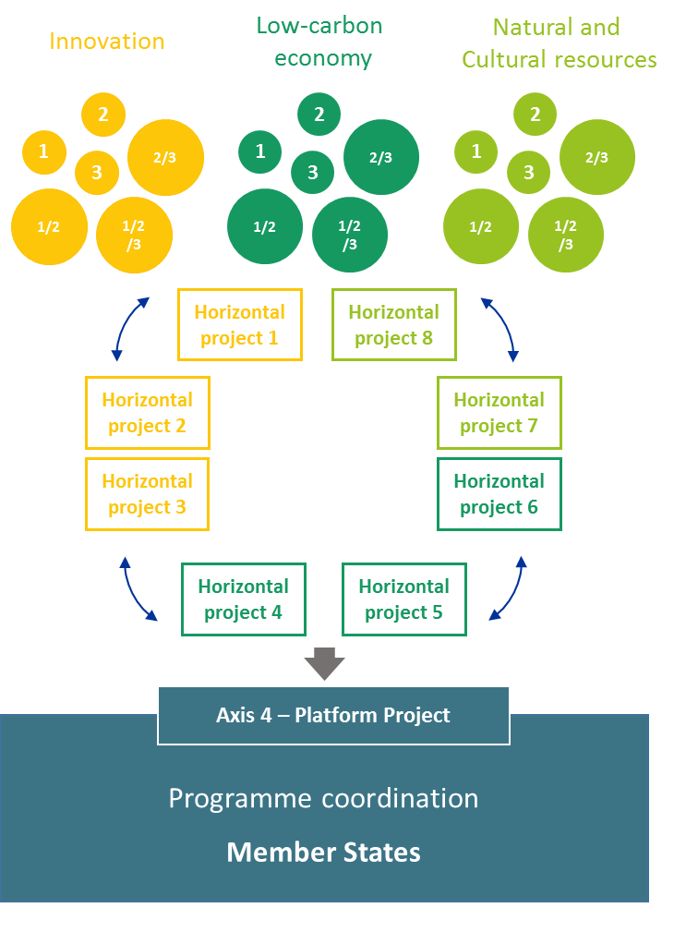
1. Strategic communication
All levels in a consistent interactivity
Modular projects level
Thematic communities /horizontal projects level
Transnational / Programme level
➔ Think on a coordination and mediation role

Slide 68
1. Strategic communication
What other resources?
Financial and human resources to ensure the project participation in external events other than the horizontal project events and seminars
Financial resources for communication campaigns or activities.
Please keep in mind
No financial resources should be allocated to the development of a website and a of logo

Slide 69
2. Logos of the MED projects
European emblem
European Cooperation
Programme
Community/Project
➔ One joint logo for the Interreg MED Community
Notes:
69

Slide 70
2. Logos of the MED projects
Notes:
70

Slide 71
3. Interreg MED
To concentrate the development and hosting of project’s web sites
To offer each project a modern website
To integrate the specific tools of the Interreg MED Programme
Responsive design; you’ll see section by section. You have to scroll down to navigate
Branded in the thematic colour; Two complementary colours: dark blue and grey.
Technology: TYPO3, version 7 LTS, launched in 2015

Slide 72
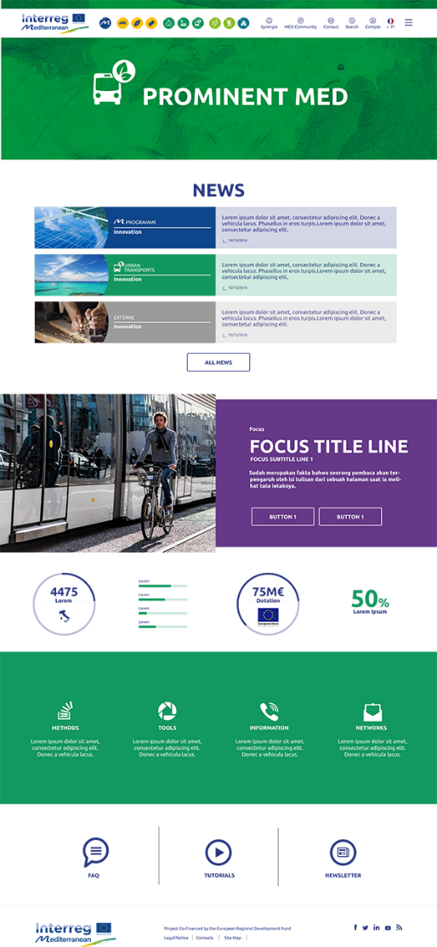
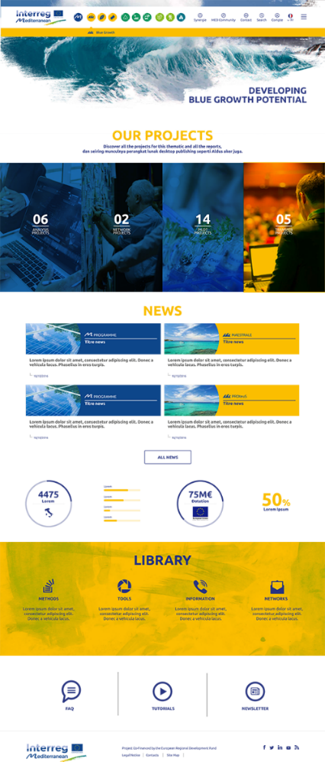
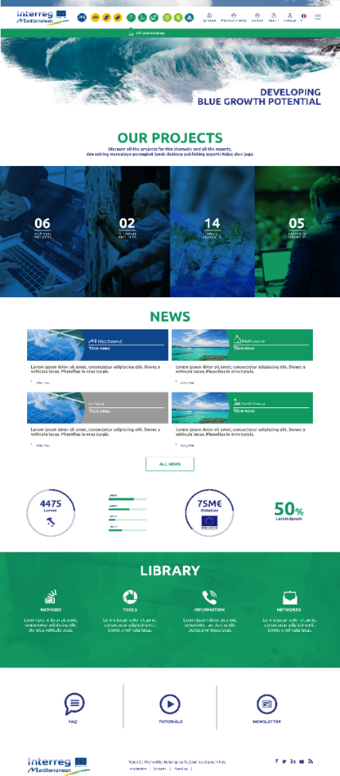
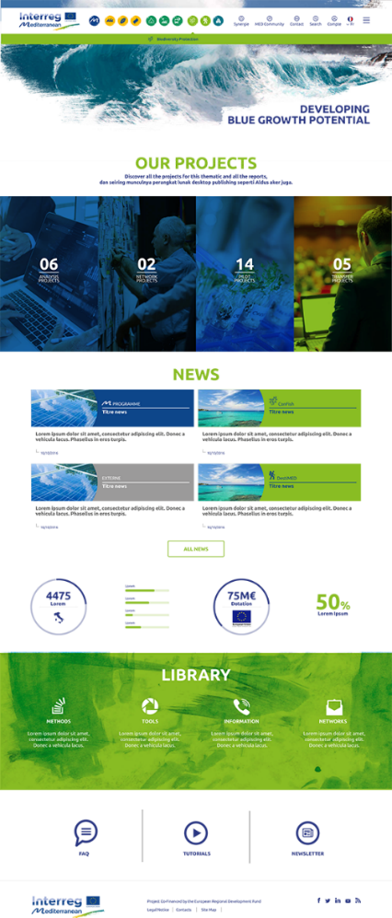
3. Projects websites
Horizontal projects
Modular projects
Notes:
These are how the Horizontal projects sites are branded by the axis colour
Your website will be branded in your thematic colour

Slide 73
3. Features
What can you do with the project website?
Publish news
Launch events
Make a complete search
Make surveys and forms
Publish FAQ, glossary, tutorials
Embed in your pages the access to external platforms through Iframe
How can you collaborate in the Platform?
You’ll have a profile…
and a internal area where you may participate or create discussion groups, share documents, subscribe RSS feeds, news and events from other sites
You can also follow the performance of your project through monitoring dashboards
You’ll be able to send mailings and newsletter
You will upload your deliverables
You may find partners and individuals in the directories
➔ Many possibilities of collaboration and coordination
Notes:
Responsive design
Full width: onscreen you’ll see it section by section. Then you have to scroll down to see the complete contents
The homepage of the website has
Optional sections : only online when there’s content: focus, counters and practical information
Permanent sections: news calendar, simbolic section, library.

Slide 74
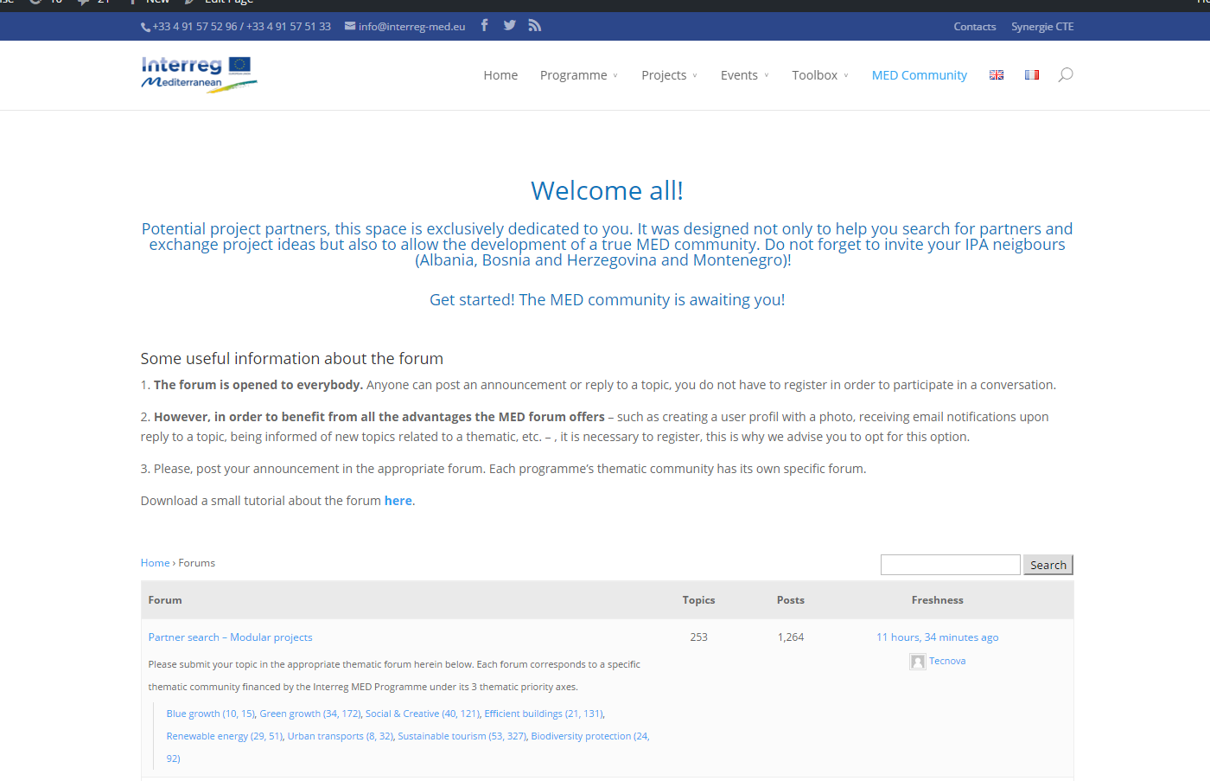
Where to find information
Have a look in the actual approved List of Operations
Search for partners and project ideas
MED Community
http://interreg-med.eu/en/first-call-for-project-proposals/
http://interreg-med.eu/en/med-community/
Notes:
74

Slide 75
Thank you for your attention www.interreg-med.eu programme_med@regionpaca.fr @MEDProgramme // EU MED Programme MED PROGRAMME PAGE

