Slide 1
«Big data» for the Sustainable growth of the Mediterranean
Bologna., 8 Febbraio 2017
Prof. Patrizio Bianchi,
Regional Minister of EU policies for development, educational and vocational training, university research and employment

Slide 2
A new science & tech revolution is changing the world economy and society
BIG DATA for life and community

Slide 3
Data science – big data is the new science approach framing all the technological development in the future
To be out of big data development means to be at the margin of the future development
Mediterranean and MP Regions must be active player in the development of big data to be relevant partners in the next European evolution

Slide 4
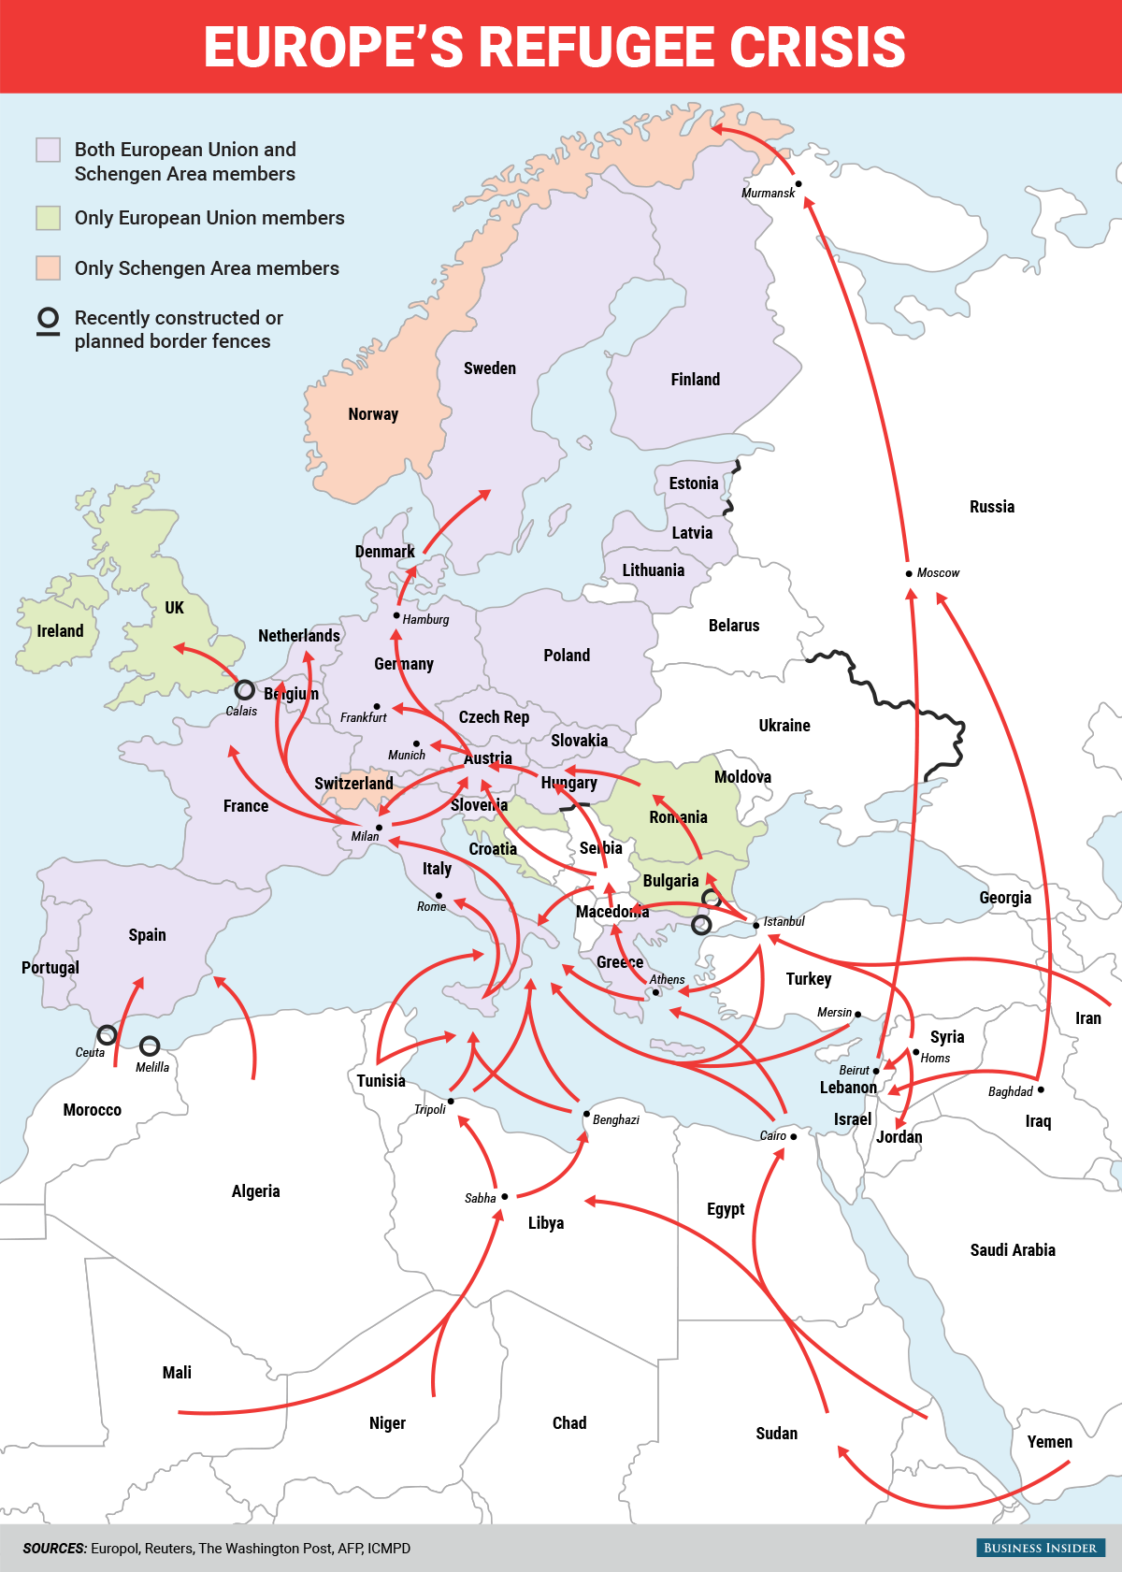
A new approach to Cohesion Policy

Slide 6
economic
political
Environmental
social

Slide 7
political
economic
And all these challenges are crucial for the development of Mediterranean macroregion
Mediterranea region: a real challenge for the future of European Union
social
Environmental

Slide 9
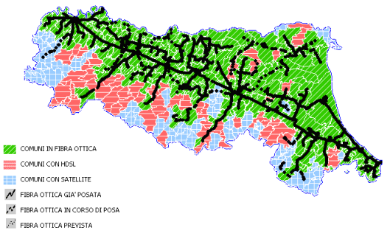
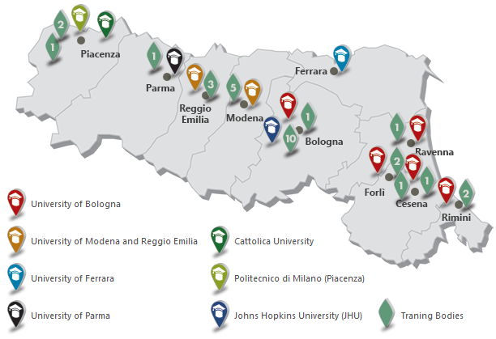
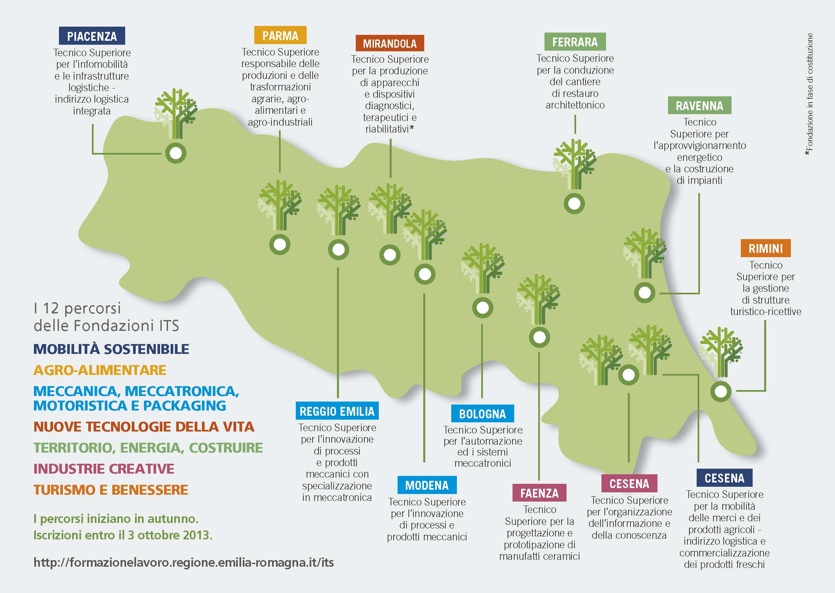
Optical Fibre Connection
HDSL connection
Satellite connection

Slide 10
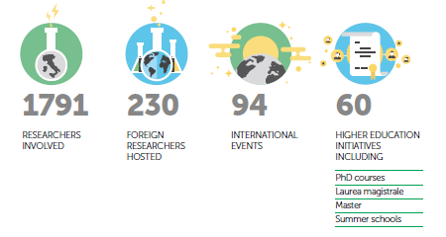
ENERGY & ENVIRONMENT
MECHANICS & MATERIALS
AGRIFOOD
CONSTRUCTION
ICT &
DESIGN
LIFE
SCIENCE

Slide 12
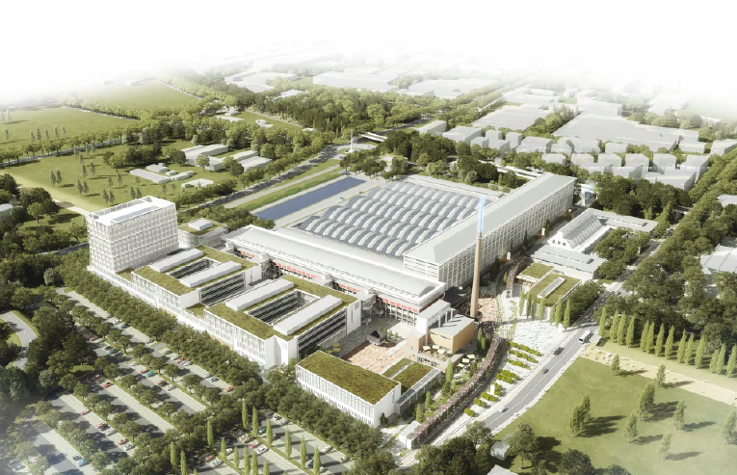

Slide 13
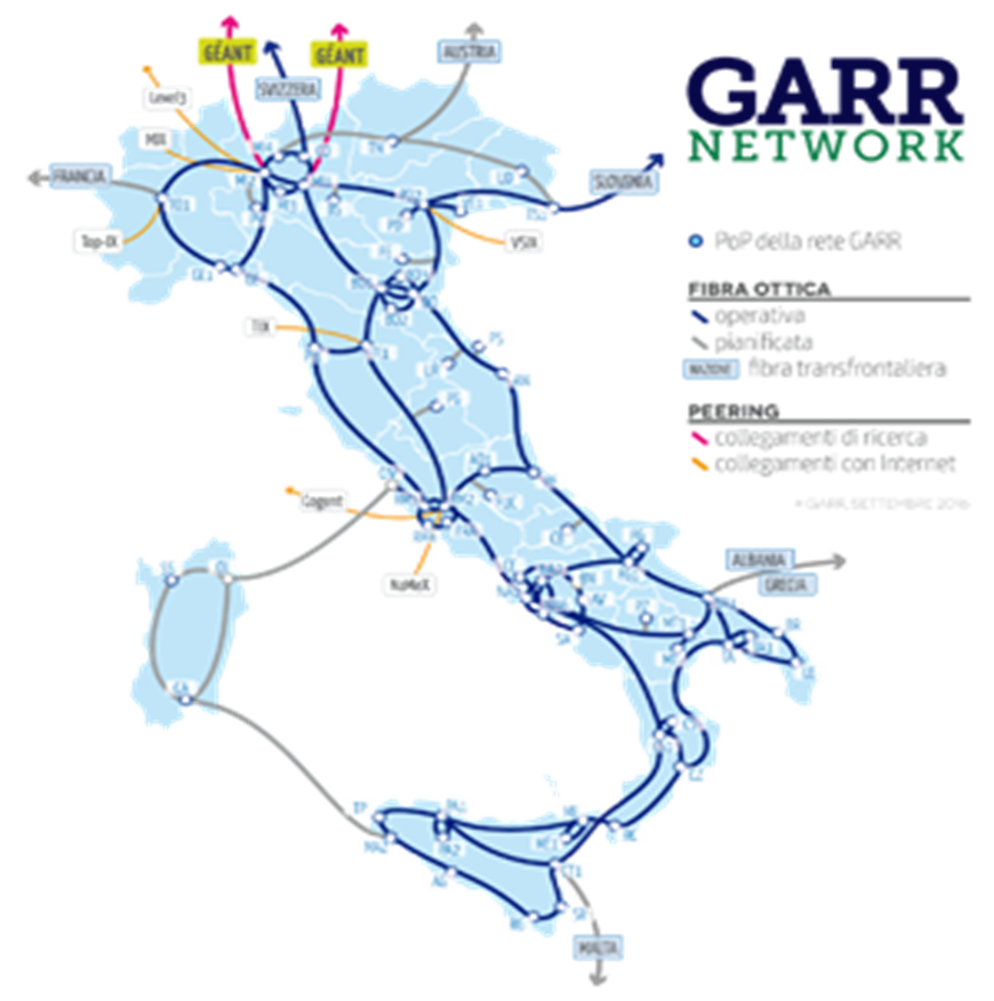
European Action
High Performance
Computering
Infrastructure
Luxemburg,
France,
Spain,
Italy

Slide 15
ADRION Program – 376 Projects at the first call 2016 (Emilia-Romagna managing authority data)
Adrion Program | First Call 2016 | Applications
Axis | Object | n.project | %
1. | Regional Innovation System | 109 | 29
2. | Natural and cultural heritage | 154 | 41
3. | Environmental vulnerability and ecosystem services | 73 | 19,4
4. | Integrated transport and multimodality | 40 | 10,6

Slide 16
Country | AXIS | TOTAL number of partners | Universities | Research Institutes
ALBANIA | 1 | 12 | 9 | 3
 | 2.1 | 11 | 11 | 0
 | 2.2 | 6 | 5 | 1
 | 3 | 1 | 0 | 1
BOSNIA AND HERZEGOVINA | 1 | 4 | 3 | 1
 | 2.1 | 5 | 4 | 1
 | 2.2 | 3 | 2 | 1
 | 3 | 3 | 2 | 1
CROATIA | 1 | 12 | 7 | 5
 | 2.1 | 15 | 8 | 7
 | 2.2 | 8 | 4 | 4
 | 3 | 3 | 2 | 1
ITALY | 1 | 39 | 17 | 22
 | 2.1 | 37 | 20 | 17
 | 2.2 | 33 | 21 | 12
 | 3 | 16 | 12 | 4
SERBIA | 1 | 16 | 7 | 9
 | 2.1 | 9 | 6 | 3
 | 2.2 | 5 | 2 | 3
 | 3 | 2 | 2 | 0
SLOVENIJA | 1 | 15 | 4 | 11
 | 2.1 | 15 | 4 | 11
 | 2.2 | 14 | 3 | 11
 | 3 | 7 | 5 | 2
GREECE | 1 | 25 | 4 | 21
 | 2.1 | 28 | 18 | 10
 | 2.2 | 21 | 7 | 14
 | 3 | 9 | 2 | 7
MONTENEGRO | 1 | 4 | 2 | 2
 | 2.1 | 6 | 3 | 3
 | 2.2 | 3 | 1 | 2
 | 3 | 1 | 1 | 0

Slide 17
Country | More active scientific partners | number of participations in projects
ALBANIA | Agricultural University of Tirana | 16
 | Polytechnic University of Tirana | 8
BOSNIA AND HERZEGOVINA | University of Sarajevo | 14
 | School of Economics and Business Sarajevo | 5
CROATIA
 | Institute of Oceanography and Fisheries | 12
 | University of Zagreb | 17
ITALY | Alma Mater Studiorum - Università di Bologna | 18
 | CNR - Consiglio Nazionale delle Ricerche | 27
 | Università degli Studi della Basilicata | 13
SERBIA | University of Belgrade | 16
 | University of Novi Sad | 11
SLOVENIJA | University of Ljubljana | 20
 | University of Primorska | 13
GREECE | Aristotle University of Thessaloniki, Special Account for Research Funds | 24
 | Centre for Research and Technology Hellas | 21
MONTENEGRO | University of Montenegro | 11
 | Public institution University of Montenegro - Institute of Marine Biology | 4

Slide 18
COMPETENCES AND SKILLS FOR DEVELOPMENT
Higher education and super academies
THE STRATEGIC ROLE OF EDUCATION AND PROFESSIONAL TRAINING

Slide 19
The need of infrastructuring South Europe with the new high tech connectivity
A new vision of an interconnected Mediterranean Sea to repositioning South Europe at the Center of EU vision
A crucial role of the Regions to design and implement a new perspective for Europe

Slide 21
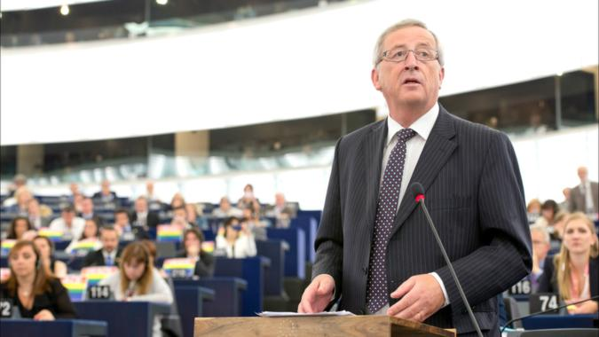
but
In the 10 priorities of the 2017 EU program there is no reference to science and tech development
There are no reference to cohesion policies
No reference to the role of the Regions

Slide 22
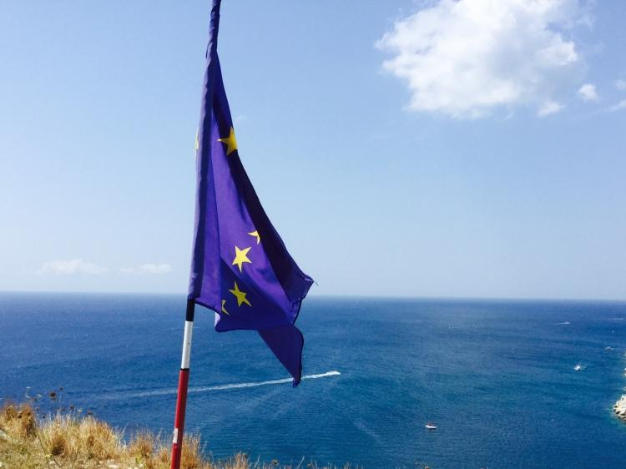
Relaunching cohesion policy toward research infrastructure in the European Regions
A CRPM position on the 10 Priorities of the 2017 EU Program (cambiare)

Slide 23
Mr Patrizio Bianchi,
Regional Minister of Emilia-Romagna (IT)
EU policies for development, educational and vocational training, university research and employment
www.regione.Emilia-Romagna.it
Patrizio.Bianchi@regione.Emilia-Romagna.it

