Slide 1
Controlli di primo livello: consigli ed errori più frequenti
JS Interreg MED
Bologna, 30/01/2018

Slide 2
BACKGROUND
Major common mistakes detected during JS check 1st payment claim
Delays in finalization of JS checks
Delayed ERDF reimbursement to partner
Ineligible expenditures
Expenditures not reimbursed
FORMAT
CONTENT

Slide 3
Issues linked to expenditure

Slide 4
Ineligible expenditure rejected by FLC (1)
Preparation costs declared as direct costs
Overhead costs declared as direct costs
Miscalculation of staffs costs, using methods of the Programme
Maximum daily allowance exceed – according to national rules
Recoverable VAT
Activities not foreseen in the application form neither validated in advance by the JS
FLC must reject the ineligible amount, qualify the type of correction – drop-down menu – and include an explanation. This information should be included also in the relevant question of the checklist of the FLC certificate.

Slide 5
Ineligible expenditure rejected by FLC (2)
Sometimes it is highly recommended not to reject the expenditure but to use other “possibilities” of Synerige CTE – and include the related expenditure in the next certificate.
Audit trail documents missing – put expenditure in hold and wait to the next certification period
Missing or wrong information/allocation & outsourcing contracts missing in Synergie CTE – request the partner to modify it
Expenditure paid after the end of the reporting period – certify the expenditure (if eligible), the system will include it in the next certificate
This will prevent the partner from having to re-enter them again

Slide 6
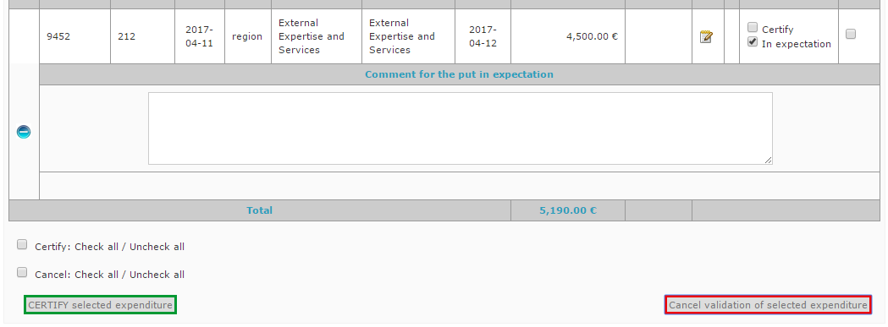
Audit trail documents missing
Instead of rejecting the expenditure, put it in hold in Synergie CTE – select “in expectation”, and control it again in the next certification.
In the following control, if the partners submits all relevant documents, FLC may certify or reject the expenditure.
More information in Synergie guide:How to certify expenditure and issue a FLC certificate in Synergie CTE

Slide 7
Missing information or wrong allocation in Synergie CTE
Comments regarding the nature of the expenditure missing or not clear enough
Several expenses are cumulated under a single entrance in Synergie CTE
Wrong allocation of expenses (budget line, WP, inside/outside Programme area)
FLC must request the partner to modify the wrong information before certifying

Slide 8
Outsourcing contracts in Synergie CTE & Public procurement rules
Outsourcing contracts above EUR 500,00 must be entered in Synergie CTE and linked to the concerned expenditure.
When FLC validates expenditure, s/he confirms that public procurement rules have been respected.
FLC must verify that all relevant outsourcing contracts have been entered in the system.
If they have not, s/he must request the partner to do it.
The MA/JS may reject a expenditure if that information is not in the system.

Slide 9
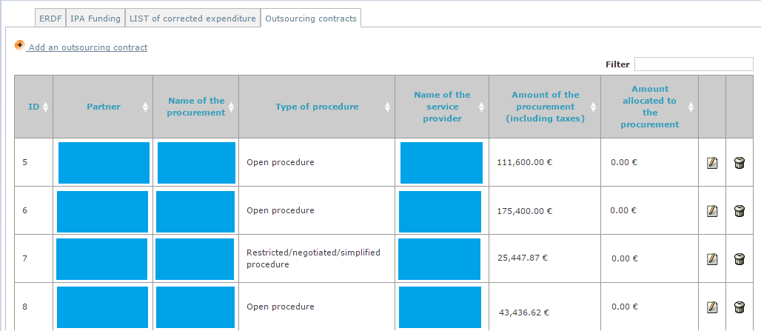
More information in Synergie guide: How to enter an outsourcing contract in Synergie CTE
Check contract information that all relevant expenditure have been allocated t it.

Slide 10
Eligibility period – payment date
Ineligible costs rejected by FLC
PREPARATION COSTS = incurred, invoiced OR paid out before the date of the approval of the proposal
Expenditure paid out more than 2 months after the project ending date
Eligible costs paid out after the end of the reporting period, but no more than 2 months after the project ending date
FLC can certify them, the system will prevent to include them in the current certificate and the will remain in the system available for the next one

Slide 11
Issues linked to the FLC certificate

Slide 12
Accounting system
Each partner must maintain either a separate accounting system or an adequate accounting code for all transactions relating to an operation.
FLC must declare which system is used by the partner, and if it works properly in question 4.1.1/2 of the each FLC certificate.
When no on-the-spot control has been carried out, desk-based checks must be sufficient to answer these questions. The on-the-spot control subsequent shall confirm the conclusions of the desk-based checks.

Slide 13
Double funding
Mechanism(s) set up by the partner to avoid the reimbursement of same expenditure by multiple means of financing (EU, national, regional, other).
Each partners has to implement a systematic and objective method that allows a real control/follow up of co-financed expenditure.
Allow a check implemented on 100% of expenditures on all cost budget lines (staff, travel and accommodation, etc…).
A declaration of the partners is not enough.
Compulsory comment explaining the mechanism(s) is to be included in question 4.1.3 of the each FLC certificate

Slide 14
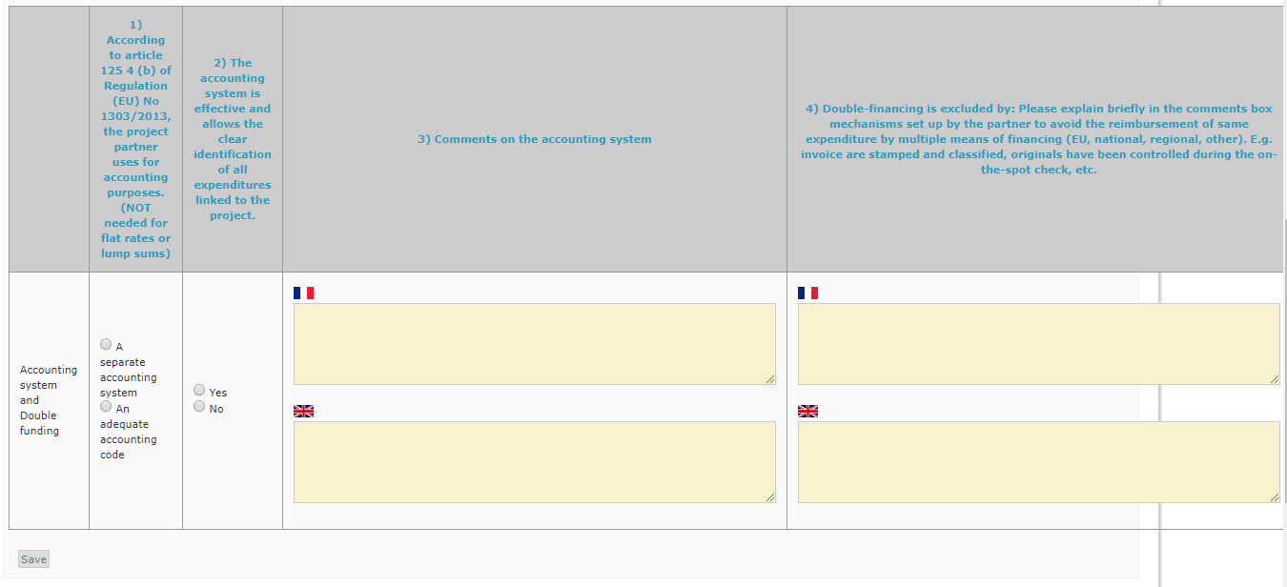
Synergie CTE – FLC certificate – 4.1
Compulsory comment in one language, include N/A in the other one.
Check that information of this section has been recorded.

Slide 15
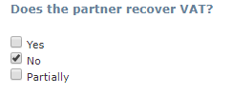
VAT – 4.2 & 3
1) VAT status declared by the partner in the application form is correct.
If the status declared is not correct, kindly ask the partner to contact the LP and the JS to modify it.
2) Recoverable VAT has been deducted.
If the VAT status of the partner is "not recoverable", it is correct and has been correctly applied to the expenditure, kindly answer N/A to the question.

Slide 16
VAT status – how to understand application form?
→ YES: Partner CAN recover the VAT; in consequence, VAT is not eligible.
FLC must check that expenditures claimed by the partner are reported without VAT. If expenditures are included in the system with VAT, FLC must reject the VAT of each concerned expenditure.
→ PARTIALLY: Partner can recover the VAT partially; in consequence, the part of the VAT that is recoverable is not eligible and the part of the VAT that cannot be recovered is eligible.
FLC must check that expenditures claimed by the partner are reported only with the non-recoverable VAT (amount excluding tax + non-recoverable VAT share). If expenditures are included in the system with VAT, FLC must reject the part of recoverable VAT of each concerned expenditure.
NO: Partner CANNOT recover the VAT; in consequence, VAT is eligible.
Partner is entitled to claim expenditures with VAT.

Slide 17
FLC certificate – sections no filled in
Answers to questions of the FLC Certificate are missing or not properly filled in, because the partner is not concerned
ALL questions MUST be answered.
If not relevant, answer N/A.
Provide the necessary clarifications. Particularly when “NO” is provided and expenditures are certified as eligible.
“NO” answer provided with no explanation in the comment box

Slide 18
FLC certificate – 4.10 – 8
Answer YES → There are gifts. Their value do not exceed EUR 50.
Answer NO → There are gifts. Their value exceed EUR 50. The exceeding amount is rejected by FLC.
Answer N/A → There is no gifts.
TIP: check the FLC certificate PFD draft version (before validating it) to confirm that all answers have been correctly saved.

Slide 19
FLC certificate – 4.9 – 1
Answer YES → There are costs allocated to the relevant budget line.
Answer NO → There is no costs allocated to the relevant budget line.
For the rest of the questions of the section, answer N/A.
Answer N/A → In that case, not possible.
TIP: check table 5.1 Financial progress of the partner – per budget lines to confirm that expenditure / no expenditure has been allocated.
Any mistake of allocation – budget line and/or WP – should be corrected by the FLC.
Guidance: « If there are no such costs, included in the certificate kindly answer N/A to this question »

Slide 20
FLC certificate – 4.9 – 1
Answer YES → There are no preparation costs allocated.
Answer NO → There are preparation cots allocated (to be rejected).
Answer N/A → In that case, not possible.
TIP: check table 5.1 Financial progress of the partner – per budget lines to confirm that no expenditure has been allocated.

Slide 21
“The FLC confirms” questions
Answer YES → FLC agrees
Answer NO → FLC does not agree; corrective measures implemented
Answer N/A → In that case, not possible.
TIP: Answers based on professional judgment as a controller based on experience and training, but not for an expertise of EU policies.

Slide 22
Net revenues and External co-financing
Cash in-flows directly paid by users for the goods or services provided by the project, such as charges borne directly by users for the use of infrastructure, sale or rent of land or buildings, or payments for services.
Part of the costs not cover by ERDF.
In the case of Italy by FONDO DI ROTAZIONE.
To be entered in Synergie CTE – Incomes – and validated by FLC
Questions: 4.16 – 5, 6, and 7
To be entered in Synergie CTE – Payments section –
Questions: 4.17

Slide 23
Some more tips

Slide 24
Tips to speed up control work and to have a feedback
Coordinate with the partner to carry out the control as soon as possible after the end of the implementation period. You have less than 3 months.
Before validating the FLC certificate definitively check carefully that all the answers and comments included are correct and been recorded properly.
When several reporting periods open, always choose the more recent one.
Do not mark certification as FINAL. The final certificate is the last one.
Collaborate with the partner in answering the request for clarifications sent by the JS.
MA/JS and CA remarks are sent to the partner and available in Synergie CTE – “contractual documents” section.

Slide 25
THANK YOU!!!
www.interreg-med.eu
Programme_med@regionpaca.fr

