Slide 1

Piloting of eco-innovative
fishery supply-chains to market
added-value Adriatic fish products
PRIZEFISH

Slide 2
INTRODUCTION AND PROJECT PRESENTATION
PRIZEFISH| UNIBO-CIRSA | ALESSIA CARIANI
Kick Off Meeting | Ravenna | 6th March 2019

Slide 3















THANK YOU ALL !
HVALA SVIMA !
GRAZIE A TUTTI !

Slide 4
INTEGRATED AND BALANCED TRANSNATIONAL PARTNERSHIP
Research Institutes
UniBO
CNR
IZOR
OGS
SMEs/Producer Organizations
Omega3
Istra
Bivalvia

Slide 5
INTEGRATED AND BALANCED TRANSNATIONAL PARTNERSHIP
Territorial development and education bodies (both public and private)
Zadar county
ASSAM
Ministry of agriculture / CAFAS
CESTHA
Region Emilia- Romagna
RERA
Istituto superiore «Remo Brindisi»

Slide 6
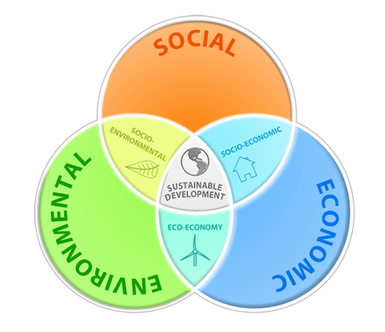
PRIZEFISH AIM
Improve sustainability of the Adriatic fisheries (environmental, social, economic) through a innovation process in the fishery and sea-food value-chain.
PRIZEFISH «3-step» motto:
«Fish better!
Gain more!
Respect the sea!»
answers to:
- environment
- economy
- society

Slide 7
PRIZEFISH KEY ACTIONS
Development and implementation of:
Fishery best practices
Improved fish products processing technologies
Innovative supply-chain and value-chain
to market eco-certified and added-value Adriatic seafood products.

Slide 8
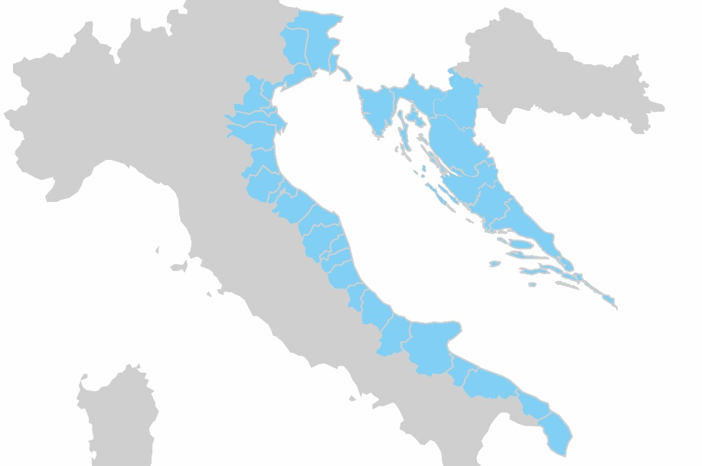

social awareness and sustainability
PRIZEFISH APPROACH
Territorial challenges tackled:
ecosystem & economic Adriatic fishery
added value innovative products
Three main integrated pillars:
high content of research & innovation
industry-driven and market oriented
capitalization in fishery-based communities

Slide 9
PRIZEFISH OBJECTIVE
Develop cross-border fishery supply-chain and value-chain of eco-innovative added-value fish products and to capitalize blue innovation for the long-term economic, environmental and social sustainability in the Programme area.
Blue innovation to improve the framework conditions of:
Adriatic fishery - SO1
Fish processing - SO2
Marketing of eco-labelled added-value products. - SO3

Slide 10
PRIZEFISH SPECIFIC OBJECTIVES
Blue innovation to improve the framework conditions of:
Adriatic fishery (SO1) - PRIZEFISH-Fishery:
Key-enabling technologies for environmental-economic sustainable Adriatic fishery.
Fish processing (SO2) - PRIZEFISH-Fish process:
Enabling SMEs to produce eco-labelled added-value Adriatic seafood.
Marketing (SO3) - PRIZEFISH-Marketing:
Increasing Adriatic SMEs competitiveness in EU and non-EU markets.

Slide 11

PRIZEFISH THEMATIC WORK PACKAGES
Blue innovation to improve the framework conditions of:
Adriatic fishery (SO1) - PRIZEFISH-Fishery:
WP3 - Piloting of sustainable and eco-certified fishery productions
Fish processing (SO2) - PRIZEFISH-Fish process:
WP4 - Innovating tools and processes for added-value Adriatic fish products
Marketing (SO3) - PRIZEFISH-Marketing:
WP5 - Building up value chain and marketing of Adriatic eco-innovative fishery products

Slide 12
PRIZEFISH THEMATIC WORK PACKAGES
PRIZEFISH-Fishery
WP3 - Piloting of sustainable and eco-certified fishery productions
3.1 Analysis of state, management and seasonality of fishery in the Adriatic sea
3.2 Selection of sustainable fisheries and guidelines on how to reach sustainability standards
3.3 Piloting of selected fishery production
3.4 Capitalizing blue innovation: eco-certification of fisheries and fishermen awareness/training
PRIZEFISH-Fish process
WP4 - Innovating tools and processes for added-value Adriatic fish products
4.1 The state of art of technological and process innovation
4.2 Design, development feasibility of specialized polyvalent-multiuse processing packaging solutions
4.3 Development and quality control of eco-innovative fishery products
4.4 Capitalizing the innovation: traceability and certification of Adriatic eco-innovative fish products
PRIZEFISH-Marketing
WP5 - Building up value chain and marketing of Adriatic eco-innovative fishery products
5.1 Market opportunities for value chain enhancement
5.2 Consumer attitude towards eco-innovative seafood products
5.3 Designing eco-innovative value chains
5.4 Capitalizing blue innovation: capacity building for market operators and local authorities

Slide 13
PRIZEFISH THEMATIC WORK PACKAGES
PRIZEFISH-Fishery
WP3 - Piloting of sustainable and eco-certified fishery productions
3.1 Analysis of state, management and seasonality of fishery in the Adriatic sea
3.2 Selection of sustainable fisheries and guidelines on how to reach sustainability standards
3.3 Piloting of selected fishery production
3.4 Capitalizing blue innovation: eco-certification of fisheries and fishermen awareness/training
PRIZEFISH-Fish process
WP4 - Innovating tools and processes for added-value Adriatic fish products
4.1 The state of art of technological and process innovation
4.2 Design, development feasibility of specialized polyvalent-multiuse processing packaging solutions
4.3 Development and quality control of eco-innovative fishery products
4.4 Capitalizing the innovation: traceability and certification of Adriatic eco-innovative fish products
PRIZEFISH-Marketing
WP5 - Building up value chain and marketing of Adriatic eco-innovative fishery products
5.1 Market opportunities for value chain enhancement
5.2 Consumer attitude towards eco-innovative seafood products
5.3 Designing eco-innovative value chains
5.4 Capitalizing blue innovation: capacity building for market operators and local authorities
Activities and deliverable are tightly linked between WPs

Slide 14
PRIZEFISH WORK PACKAGES DELIVERABLES
WP 3.1 Analysis of state, management and seasonality of fisheries in the Adriatic sea:
D3.1.1: Report of the mapped fisheries in Italy [M10].
D3.1.2: Report of the mapped fisheries in Croatia [M12].
WP 4.1 The state of art of technological and process innovation:
D4.1.1: Report of present production status of target species and their relevant processing industry [M6].
D 4.1.2: Report of the possible innovative processing solutions [M10].
WP 5.1 Market opportunities for value chain enhancement:
D5.1.1: Supply chain report [M15].
D5.1.2: Best practice guide [M18].
WP 3.2 Selection of sustainable fisheries and guidelines on how to reach sustainability standards:
D3.2.1: Report on Consultation Meeting with relevant fishing operators in Italy [M16].
D3.2.2: Report on Consultation Meeting with relevant fishing operators in Croatia [M16].
D3.2.3: Sustainability guidelines [M24].
WP 4.2 Design, development feasibility of specialized polyvalent-multiuse processing packaging solutions:
D4.2.1 Brochure of products lines [M10]
D4.2.2 Guidelines/Technical papers of solutions for innovative production solutions [M15].
D4.2.3 Courses and training, with mini-piloting, on developed innovative production solutions [M20].
D4.2.4 List of prototyped innovative products and solutions (including processing) [M24].
WP 5.2 Consumer attitude towards eco-innovative seafood products:
D5.2.1: Consumer analysis report [M24].
WP 3.3 Piloting of selected fisheries production:
D3.3.1: Report on the standardized approach in the pre-assessment process in Italy and Croatia [M20].
D3.3.2: Report of the pre-assessment of relevant fisheries in Italy [M24].
D3.3.3 Report of the pre-assessment of relevant fisheries in Croatia [M24].
D3.3.4: Standardized action plans in Italy and Croatia [M24].
WP 5.3 Designing eco-innovative value chains:
D5.3.1: Eco-innovative value chains design recommendations [M24].
WP 4.3 Development and quality control of eco-innovative fishery products:
D4.3.1 Report on new product analyses and description [M24].
D4.3.2 Report on Standards’ qualification [M24].
D4.3.3 Report on Products’ certification [M27].
WP 5.4 Capitalizing blue innovation: capacity building for market operators and local authorities:
D5.4.1: Joint cross-border training modules [M27]. D5.4.2: Policy recommendations [M30].
WP 3.4 Capitalizing blue innovation: eco-certification of fisheries and fishermen awareness/training:
D3.4.1: Socio-economic survey for fishing operators in Italy and Croatia [M20].
D3.4.2: Two Target Groups/Stakeholder meetings in Italy and Croatia [M20].
D3.4.3: Cross-borders training modules [M27].
WP 4.4 Capitalizing blue innovation: traceability and certification of eco-innovative fishery products:
D4.4.1: Guidelines for traceability implementation on new products [M18].
D4.4.2: Certification scheme for new innovative products and process [M24].
D4.4.3: Joint cross-border training modules [M27].
Activities and deliverable are tightly linked between WPs

Slide 15
PRIZEFISH SCHEDULE

Slide 16




Thanks for your attention
Alessia Cariani
Inter-Departmental Centre for Research in Environmental Sciences, University of Bologna
Via Sant’Alberto 163
alessia.cariani@unibo.it
+39 0544 937321 / +39 320 6951145
www.italy-croatia.eu/prizefish (cooming soon)
www.cirsa.unibo.it/en

