Slide 1

Stefano Segadelli and
Maria Teresa De Nardo
Emilia-Romagna Region Direction for Territory and Environmental Care - Geological, Seismic and Soil Service (Servizio Geologico, Sismico e dei Suoli-SGSS)
Aquifers and springs in the Emilia-Romagna Apennines: the contribution of geology for the protection of biodiversity in wetlands

Slide 2
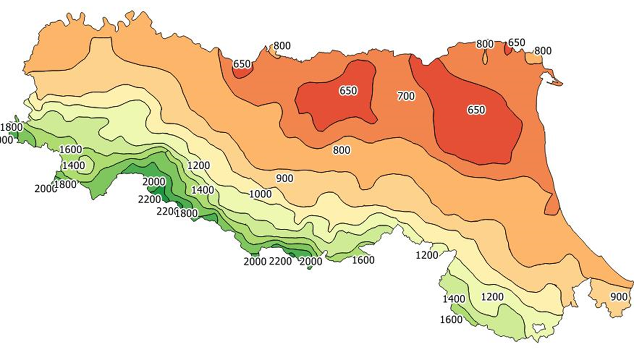
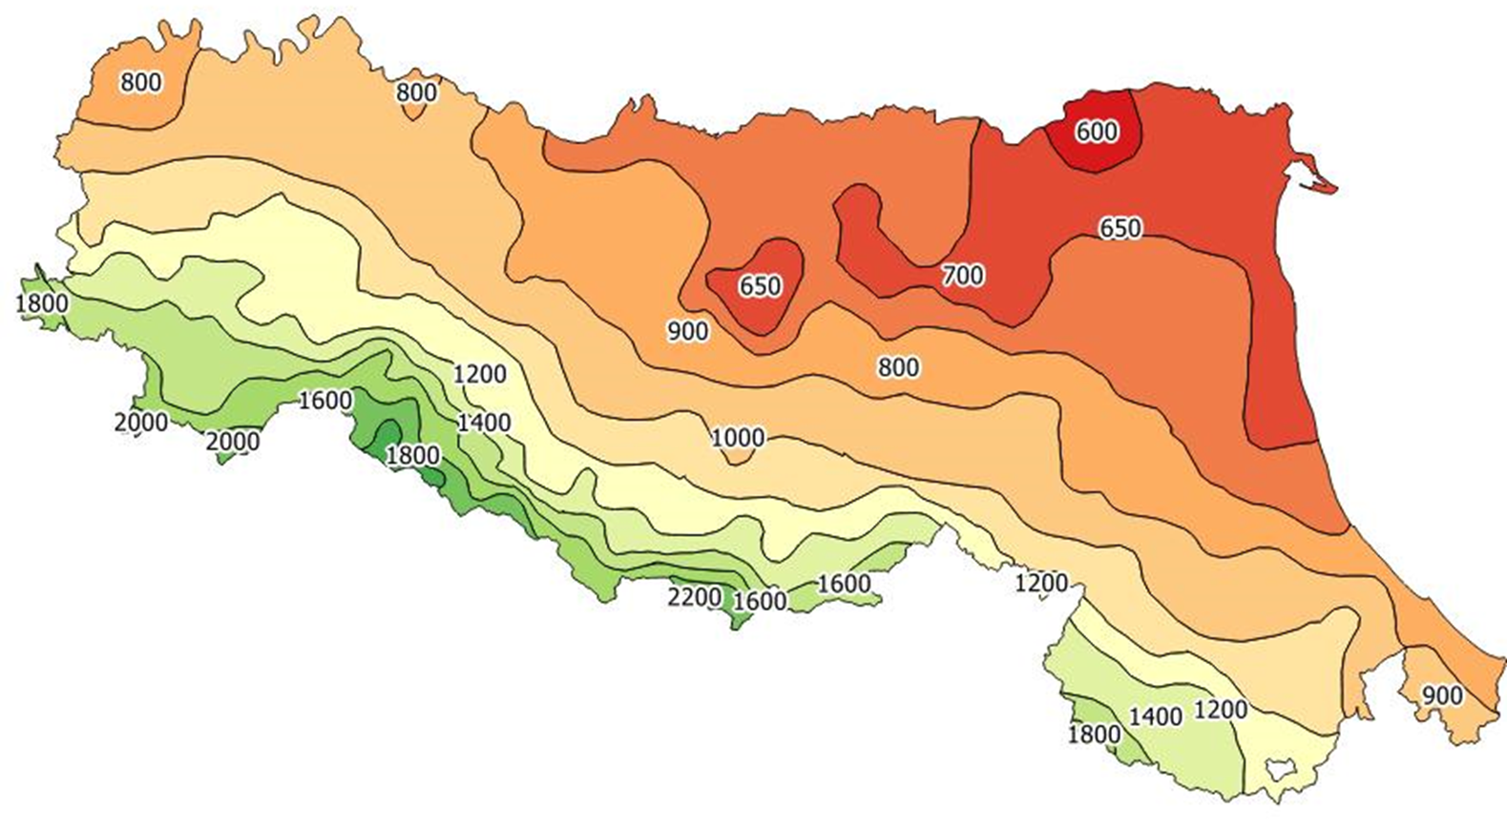
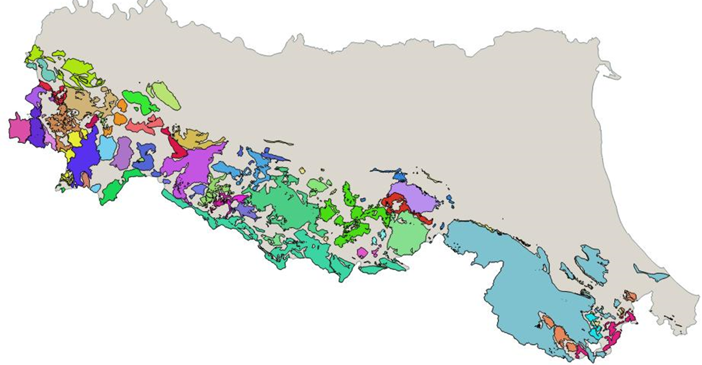
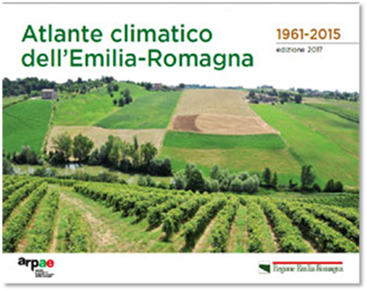
Precipitation over time and water availability
1961-1990
1961-1990
Valori medi delle precipitazioni annue (mm/anno)

Slide 3
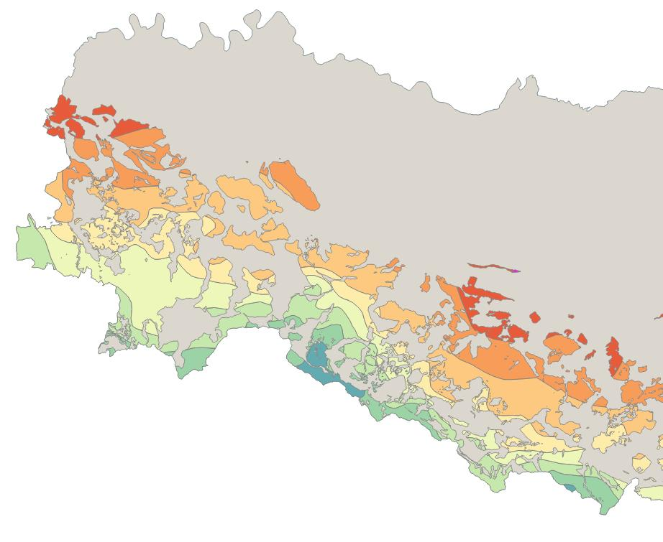
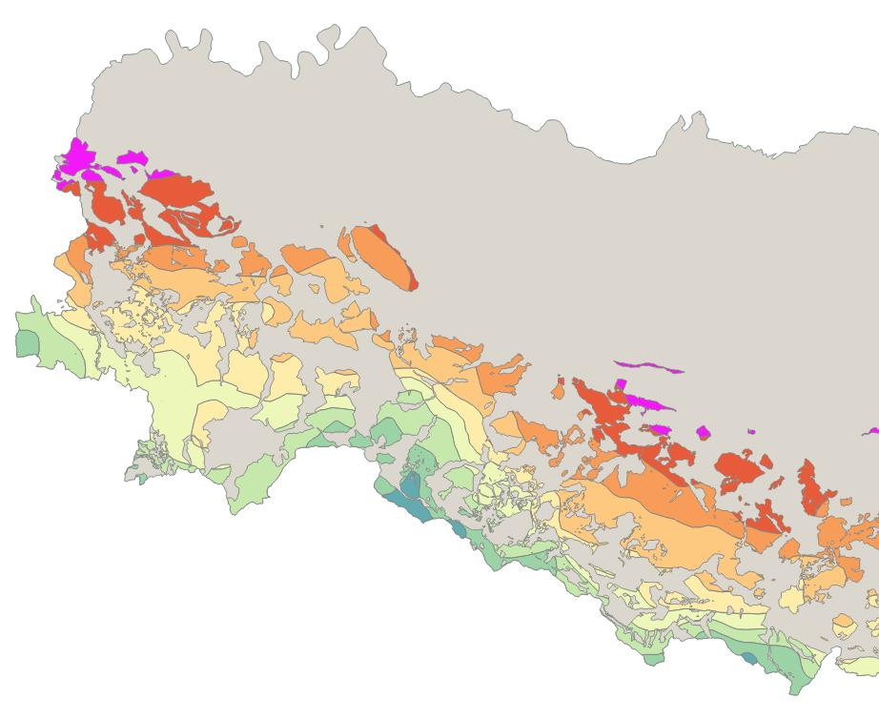
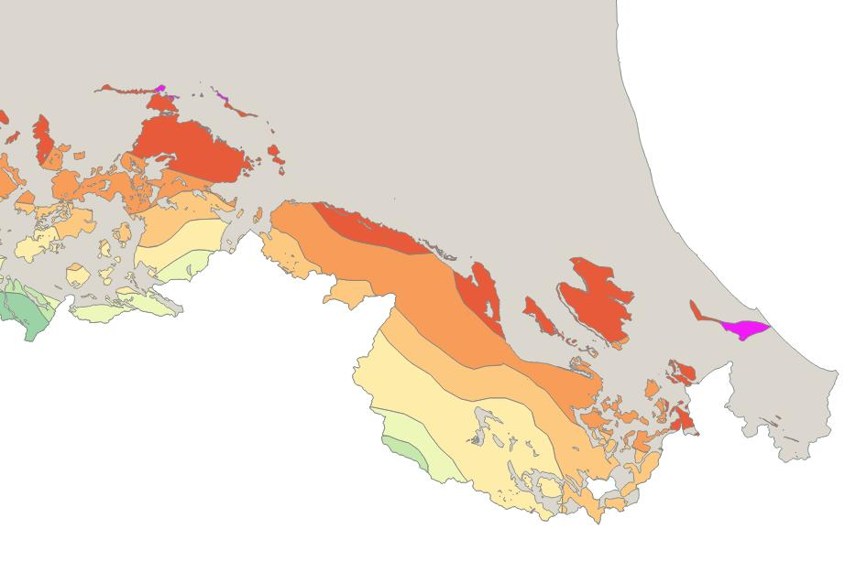
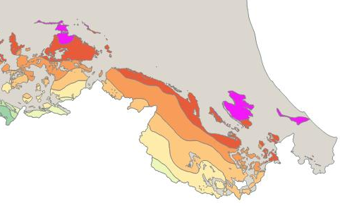
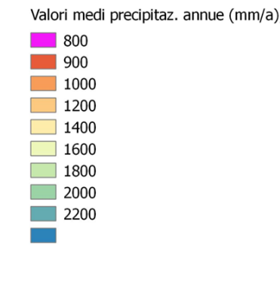


Western and central mountain sector
Precipitation and mountain aquifers
1961-1990
1991-2015
Eastern mountain sector
> 2200
Ridracoli dam

Slide 4
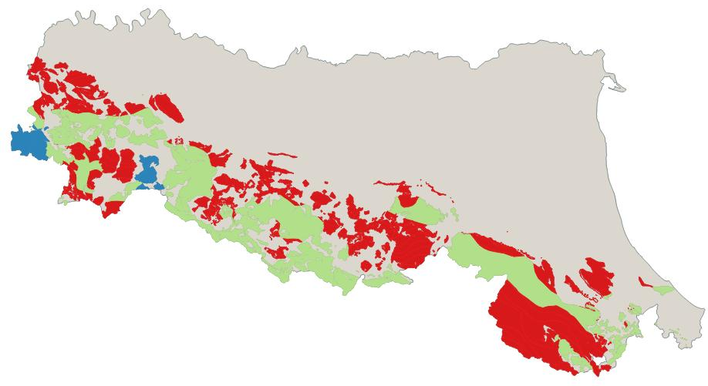

Generalisation: inflows on mountain aquifers SGSS 1961-2015
Difference between Average values of annual precipitation, intervals 1961-1990 and 1991-2015. ARPAE-SIMC and SGSS data
Red, decrease trend, local maximum value -200 mm / year
Green, conservation trend
Blue, increase trend, local maximum value + 200 mm / year

Slide 5
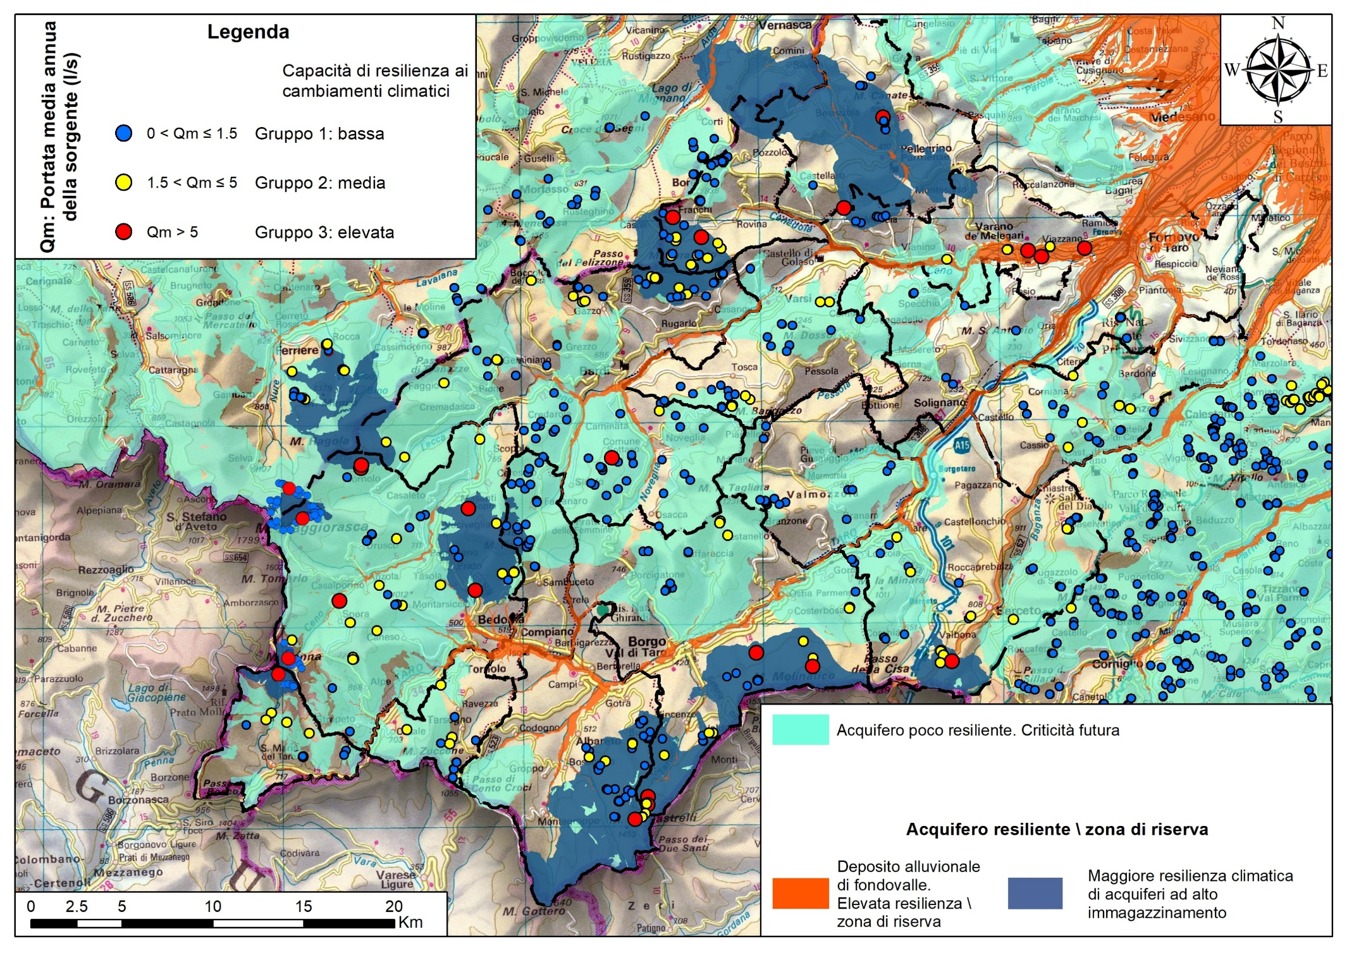

Slide 6
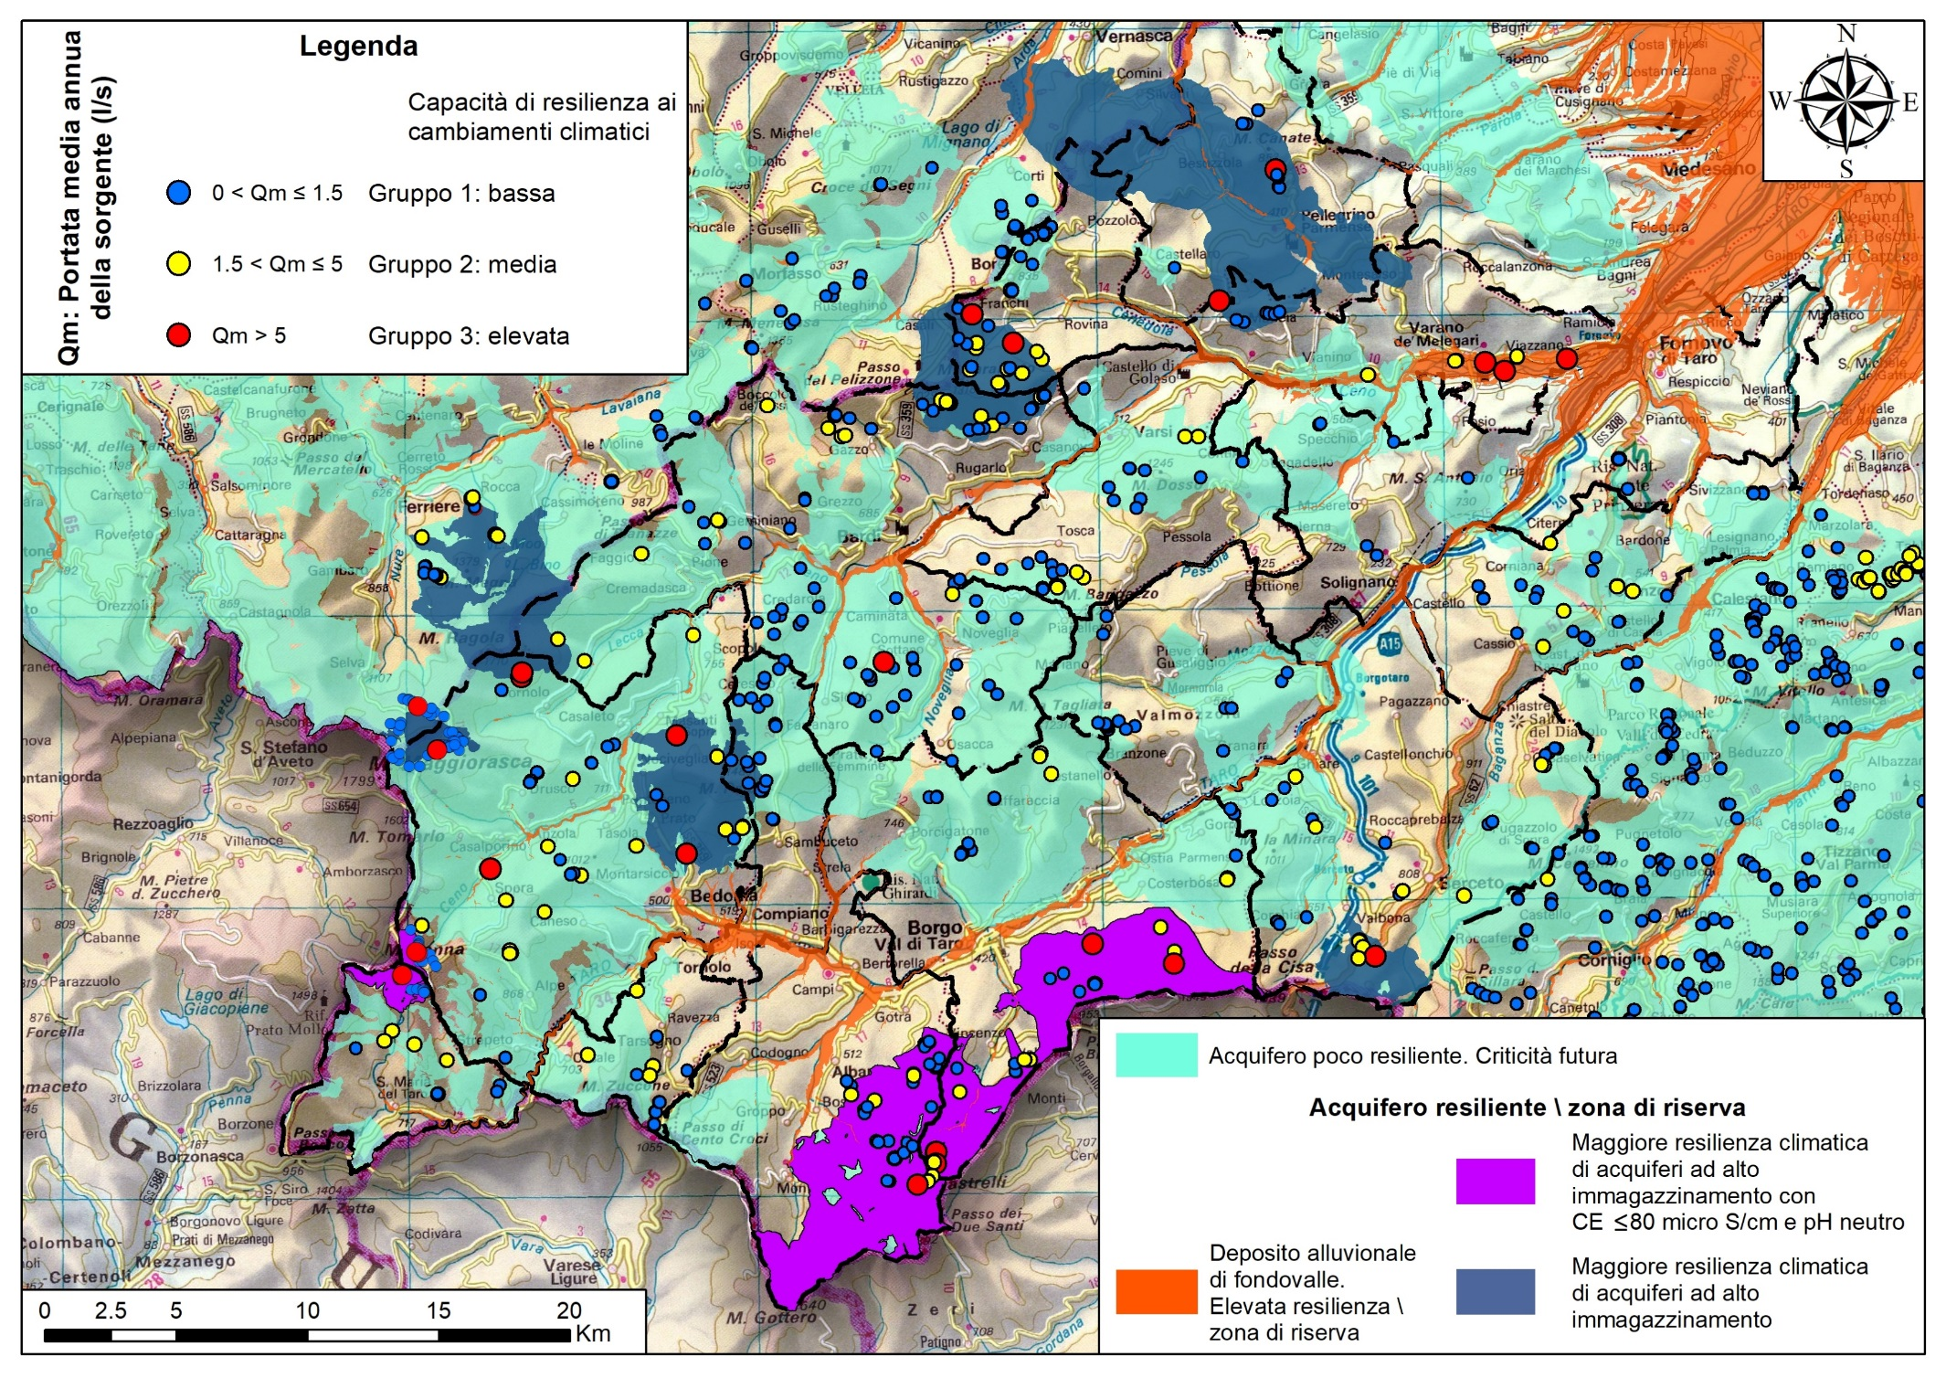
Graphoderus bilineatus predilige
bacini con pH tra 5,5 e 7
e CE inferiore a 90 micro S/cm

Slide 7
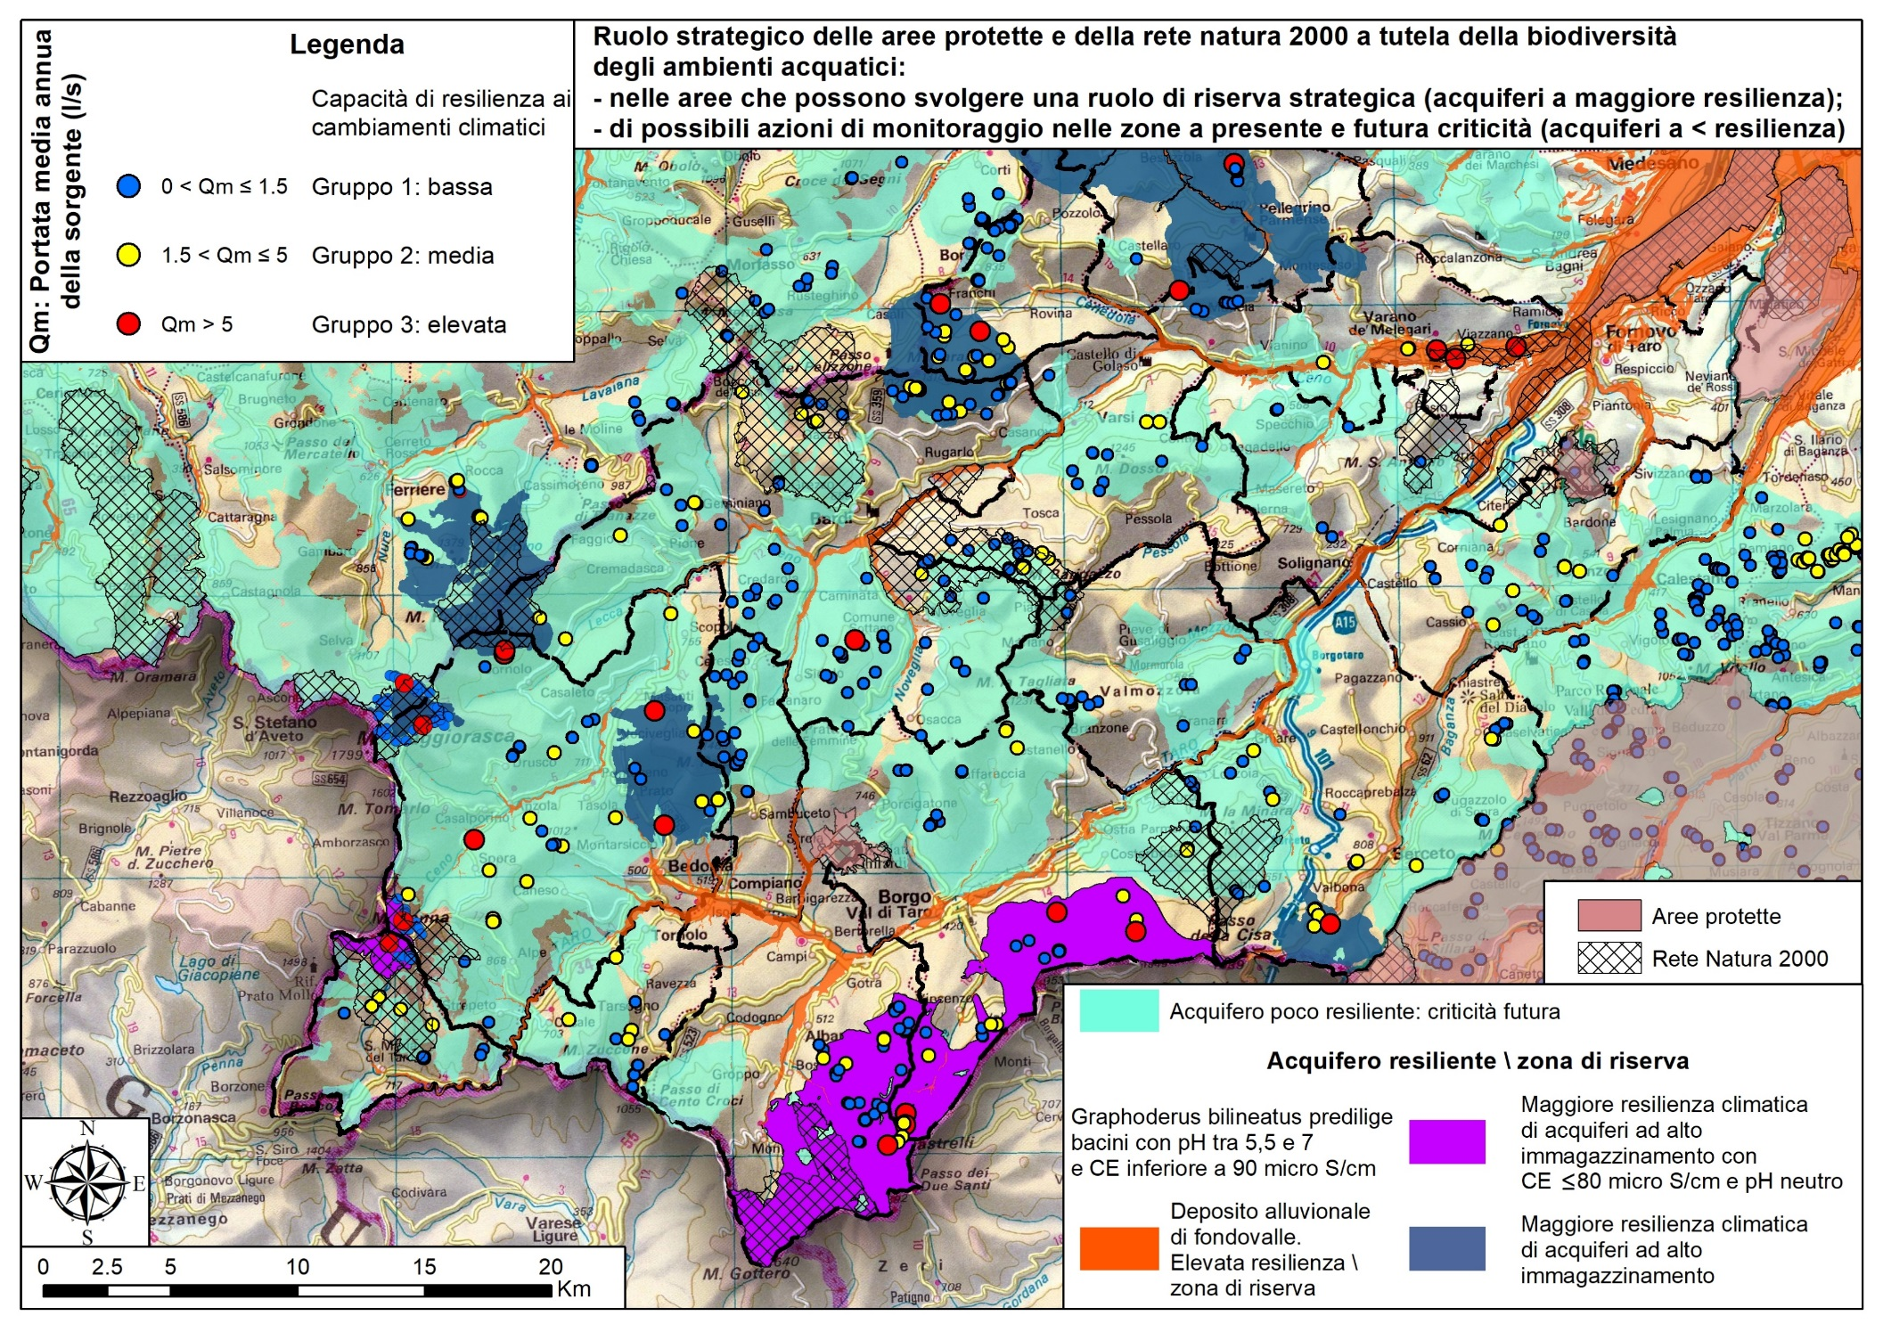

Slide 8
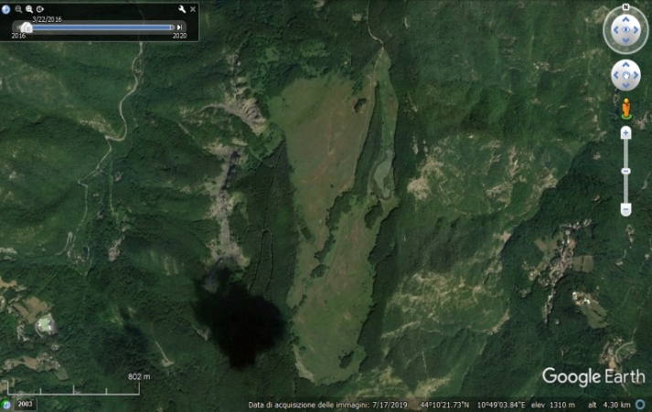
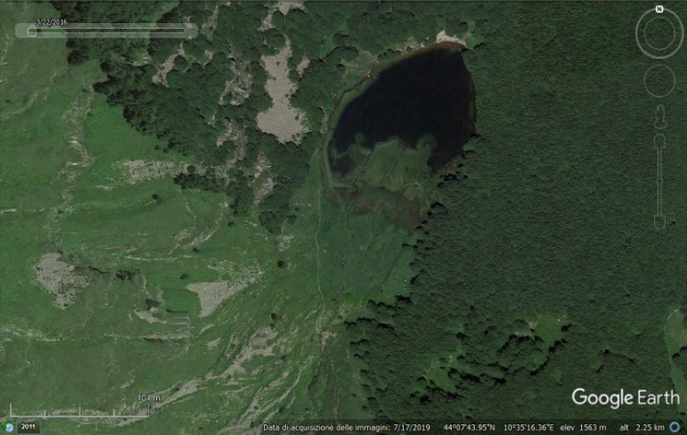
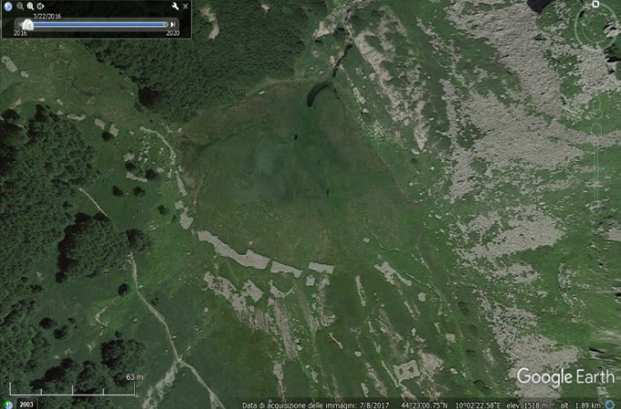
Since 2017, a collaboration has been in place between the Geological, Seismic and Soil Service (SGSS) and ARPAE- Idro-Meteo-Climate Service (ARPAe-SIMC), for the study of some high-altitude peat bogs in the Emilian Apennines.
Coring at: Lago Moo (PC); Lagdei (PR) and the Febbio peat bog (RE)
Objective: To reconstruct the variations over time of high-intensity precipitation in the northern Apennines using high-altitude peat bogs as natural archives
The observed sedimentation rate is approximately 1 m every 100 years,
starting from the 19th century.
The results of this collaboration activity are available at the following link:
Changes in high-intensity precipitation on the northern Apennines (Italy) as revealed by multidisciplinary data over the last 9000 years https://cp.copernicus.org/articles/16/1547/2020/
Lake Pratignano (Modenese Apennines 1309 m a.s.l.)
Lake Baccio (Modenese Apennines
1560 m a.s.l.)
Badignana (Parma Apennines
1511 m a.s.l.)

Slide 9
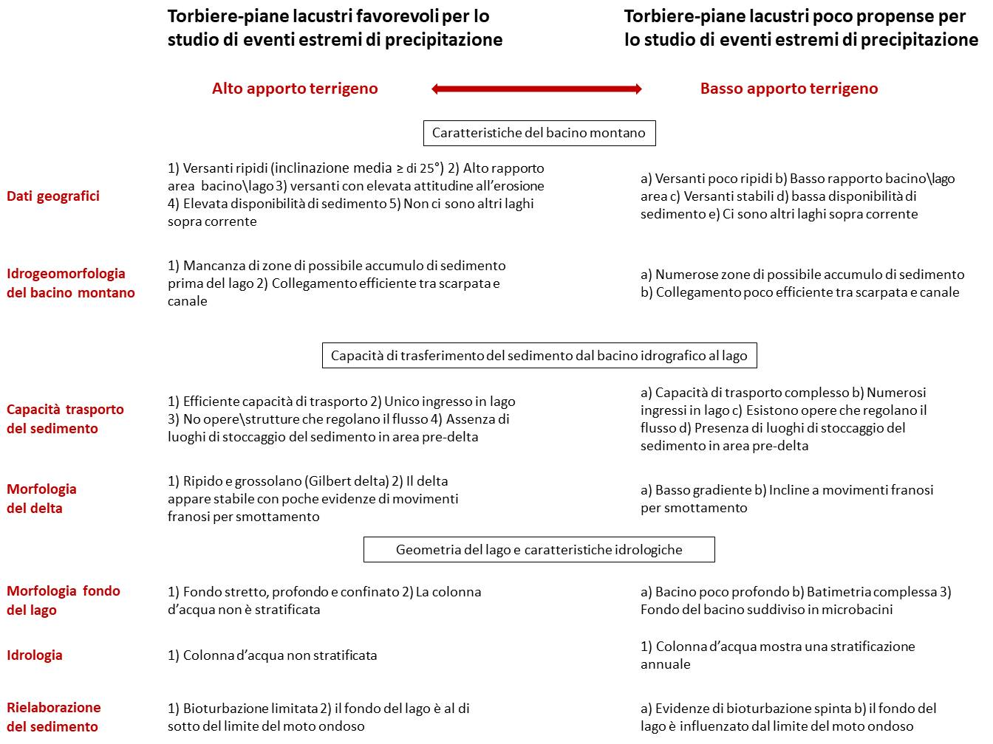
Aquatic environments with a high risk of extinction
Aquatic environments with a low
risk of extinction

Slide 10
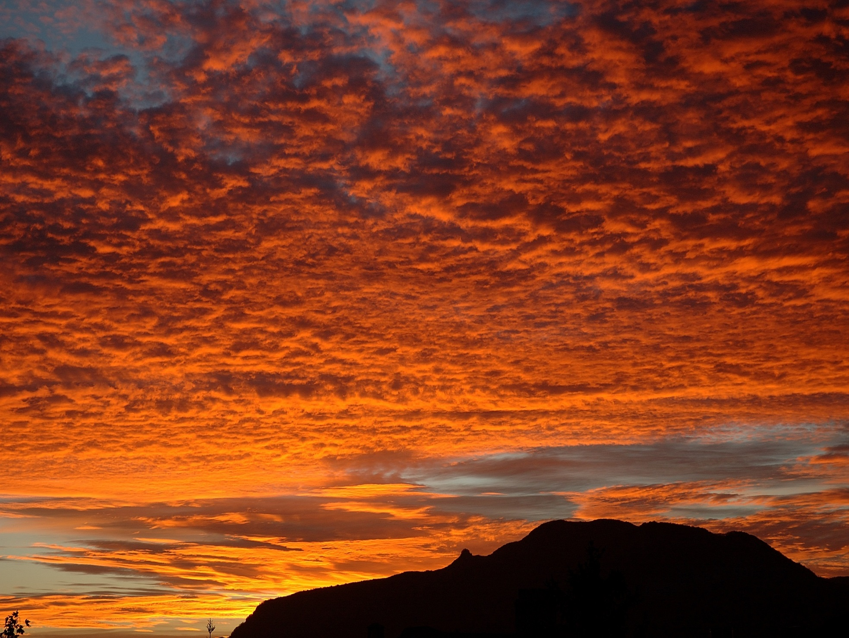
Thank you for your attention

