Slide 1


Gabriele Cassani
Roberto Fabbri
Life Eremita Project: environmental recovery / improvement interventions of the Romagna rivers for the conservation of Coenagrion mercuriale castellani (Odonata)
Ente di Gestione per i Parchi e la Biodiversità Romagna

Slide 2


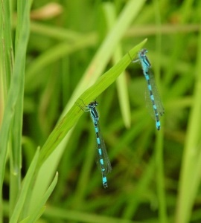
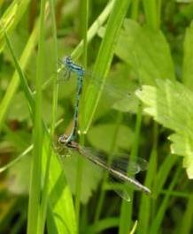
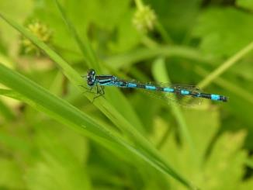
Southern damselfly
Coenagrion mercuriale castellani
Odonata Insects (Dragonflies)
Species present in some small freshwater streams, very stenoecious. It flies from the end of March to July, with reappearance between August-October (bivoltine). Total adult length 27-31 mm and maximum wingspan 15-20 mm. In the region it is very localised, with very few sites of presence and is considered very vulnerable. It is included in Annex II of the Habitat Directive 92/43 / EEC.

Slide 3
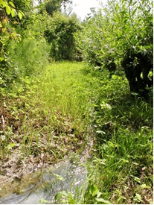
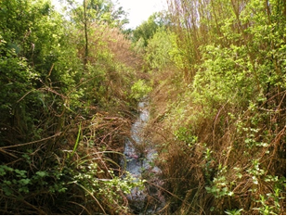
Coenagrion mercuriale castellani
Ecology
C. mercuriale castellani is associated with running waters (rarely stagnant but in any case, fed by spring streams), even cold, not excessively fast, and in particular streams, springs and resurgent springs, often of karst nature up to 750 m in altitude. An essential feature for the suitability of the habitat is that there is always water and the presence of dense riparian and submerged vegetation; the latter is used for laying eggs by the female, who can even completely immerse herself in the water.
Streams fed by springs with settled populations of C. mercuriale castellani

Slide 4

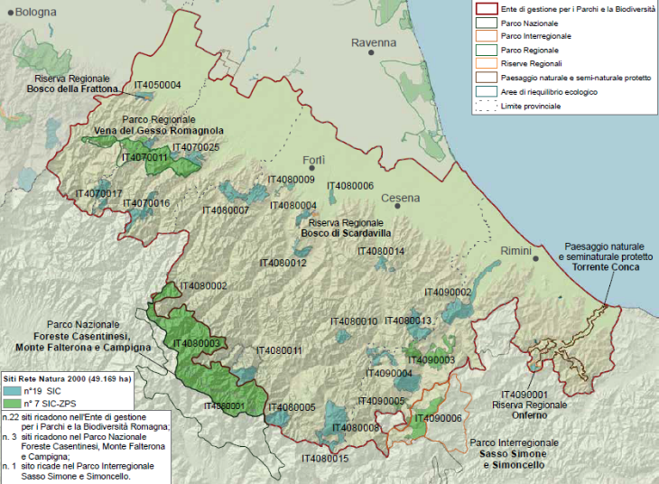
Coenagrion mercuriale castellani
Presence 2016-2017 before Life interventions

Slide 5
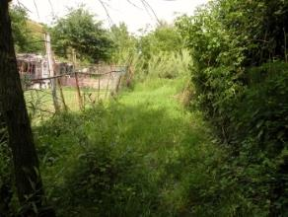
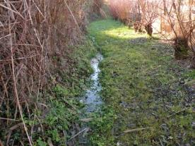
Coenagrion mercuriale castellani
Threats
- rarefaction and loss of small suitable streams
- low dispersion rate
- very isolated populations
Threats in detail
- water extraction for various purposes
- course deviations
- excessive grazing of cattle on the banks
- breeding of other animals on the margins
- domestic animals in the riverbed
- exotic animals in the riverbed
- wild boars’ mudhole
- ecological succession and too much shade
- burial
- agriculture on the margins and banks
- industrial or construction activities
- cleaning and weeding of the ditches at the edge of the roads
- discharges

Slide 6
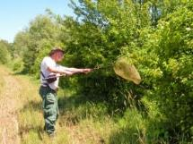
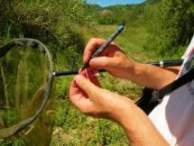
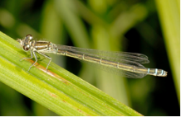
Coenagrion mercuriale castellani
Actions of the Life Eremita for Coenagrion
Monitoring to know in detail the distribution of the species and the size of the population
Census of suitable habitats (rivulets, streams always fed)
Recovery of small streams
Translocation for reinforcement and reintroduction
Final monitoring

Slide 7

Action C2 - Recovery of streams suitable for Coenagrion mercuriale castellani in the Romagna Macroarea
Plan for the recovery and improvement of riparian areas in order to increase the availability of suitable habitats for Coenagrion mercuriale castellani in the SAC IT4070011 and in the SAC IT4090002
Objective:
- Recovery or improvement of suitable environments for Coenagrion mercuriale castellani. Ecological needs:
- The species requires small, sunny streams, where herbaceous cover prevails near watercourses with modest variations in water flow and temperature.
- It avoids shady areas, while it prefers spaces covered by equisetum (horsetails) and aquatic species not exceeding one metre in height.

Slide 8
Action C2 - Recovery of streams suitable for Coenagrion mercuriale castellani in the Romagna Macroarea
Method:
-Elimination of stretches of shrub cover and poplar and willow nuclei.
To create:
- Grassland areas in connection with the watercourse, suitable as hunting areas for adults of the species;
-Sunny areas subject to current flow covered by aquatic species, useful for hosting the reproductive function.
Note. Possible misunderstandings with the owners, who often expect traditional reshaping of the riverbed with a hydraulic regulation function, while here the herbaceous cover of the bottom and banks is not touched.

Slide 9
Action C2 - Recovery of streams suitable for Coenagrion mercuriale castellani in the Romagna Macroarea
Time schedule:
• The works were carried out with an initial intervention between February and March 2019, which was followed by a touch up on the regrowth in autumn-winter 2019;
• A further intervention planned before the restart of the 2021 growing season, to consolidate the results obtained;
• Scheduled interventions before the restart of the vegetative season also in the following years.

Slide 10
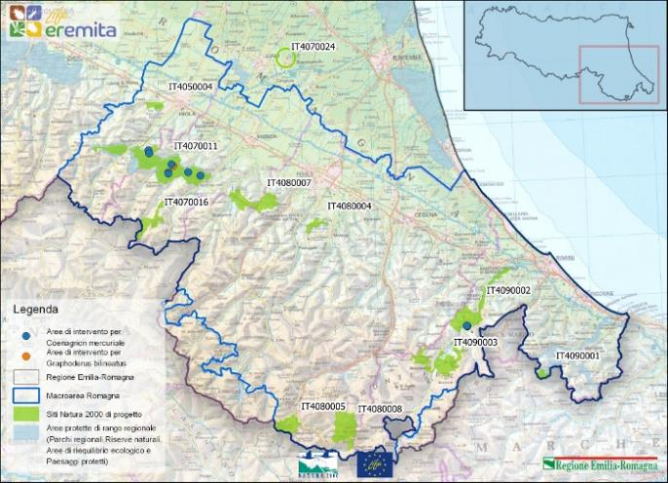
Action C2 - Recovery of streams suitable for Coenagrion mercuriale castellani in the Romagna Macroarea
Localization of the 6 areas of interventions for C. mercuriale castellani with the 9 streams

Slide 11
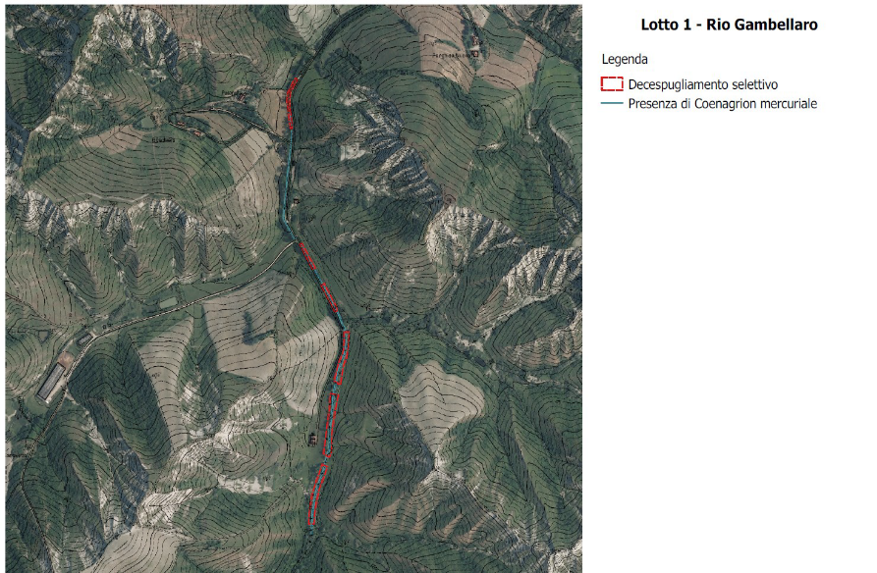
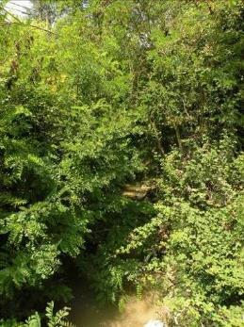
Map of Stream 1 in the municipality of Casola Valsenio (RA) with the sections on which the interventions were carried out
Lotto 1 – Rio nel comune di
Casola Valsenio
Rio CV1

Slide 12
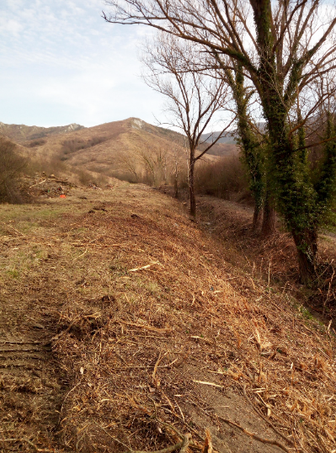
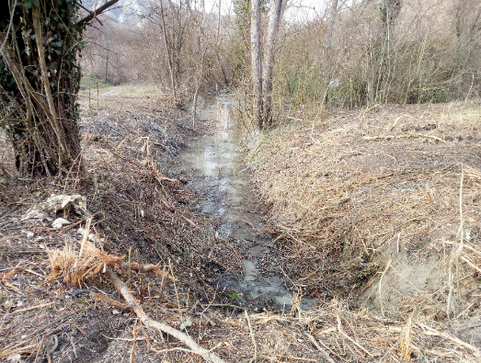
Stream 1 in the municipality of Casola Valsenio (RA) after the vegetation control interventions

Slide 13
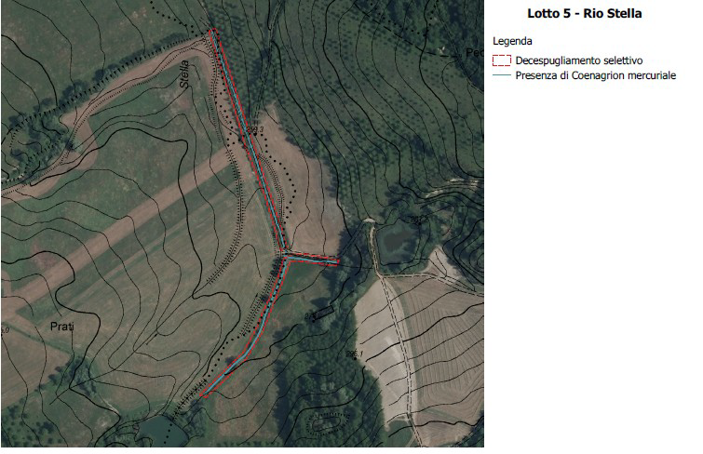
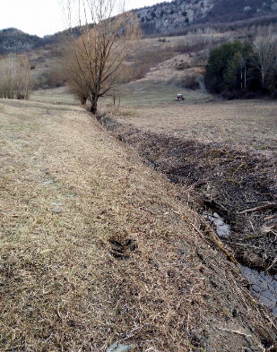
Map of Streams 2 and 3 in the municipality of Casola Valsenio (RA) with the sections on which the interventions were carried out
Lotto 5 – Rii 2 e 3 nel comune di
Casola Valsenio
Rio CV2
Rio CV3

Slide 14
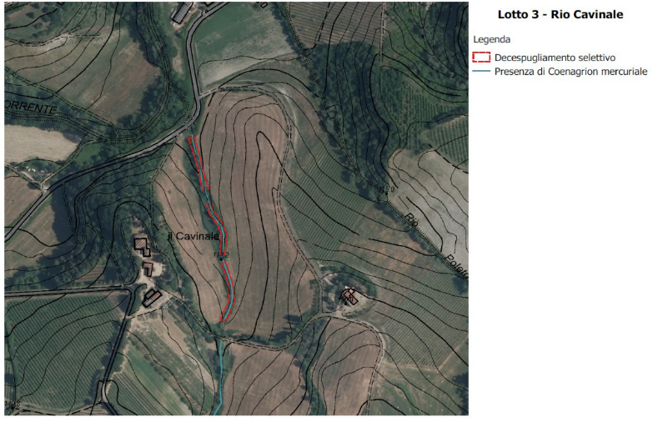
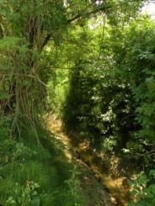
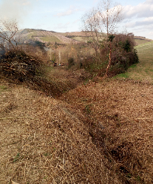
Map of Stream 3 in the municipality of Brisighella (RA) with the sections on which the interventions were carried out
Lotto 3 – Rio nel comune di
Brisighella
Prima
Rio Br3
Dopo

Slide 15
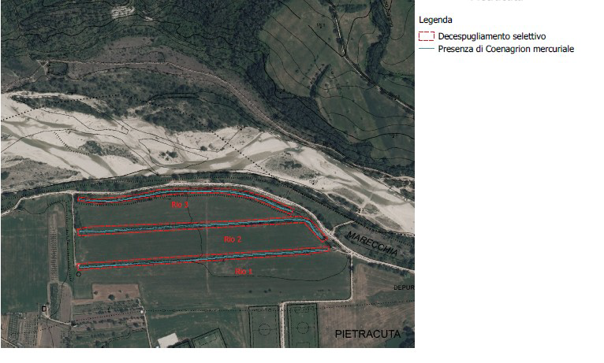
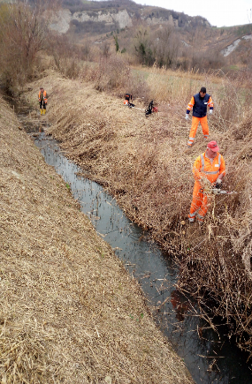
Map of the Streams 1-2-3 in the municipality of San Leo (RN) with the sections on which the interventions were carried out
Lotto 6 – Rii 1-2-3 nel
comune di San Leo
Rii SL1-2-3

Slide 16

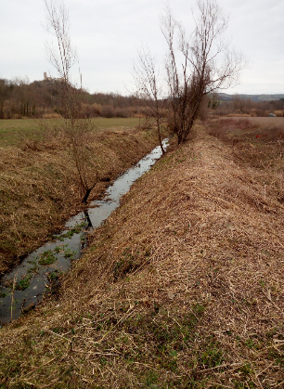
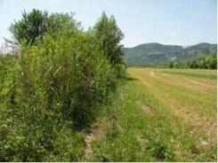
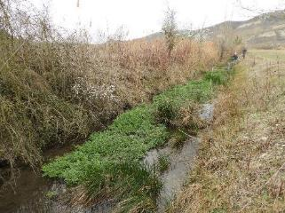
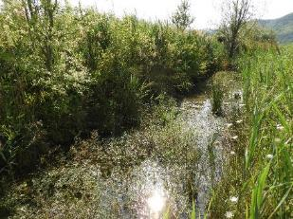
Stream 1 in the municipality of San Leo (RN) after the vegetation control interventions
Before
After interventions
After intervention (spring)

Slide 17
Action C2 - Recovery of streams suitable for Coenagrion mercuriale castellani in the Romagna Macroarea
Food for thought.
Different approaches to the analysis and management of riparian environments:
-Hydraulic approach (the water body as a container for flood volumes).
- River ecology approach that operates through indicators of fluvial functionality with a central role attributed to the vegetation of the banks (large and diverse ecosystems).

Slide 18
Action C2 - Recovery of streams suitable for Coenagrion mercuriale castellani in the Romagna Macroarea
The interventions implemented for Coenagrion mercuriale castellani appear to be in contrast with the principles of river ecology, as they operate a regression towards less advanced forms of the riparian structure.
The apparent contradiction is resolved by taking another approach, that aimed at protecting biodiversity.
Great attention must be paid to the creation of interdisciplinary contexts, in which the exchange between the different technical-scientific cultures can prevail in order to build a synoptic vision that at least remotely can approximate the infinite complexity of the natural world.

Slide 19
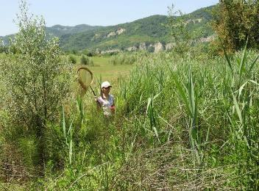
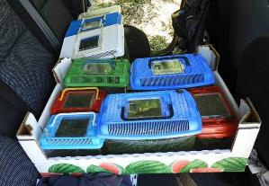
Action C5 - Translocation of Coenagrion mercuriale castellanii Romagna Macroarea Release period
Periodo di rilascio Coenagrion mercuriale castellani | No. of adults | No. of release streams | No. of release sessions | Recapture period
June 2019 | About 300 | 4 | 3 | June-August 2019
May 2020 | Over 200 | 5 | 2 | May-July 2020

Slide 20
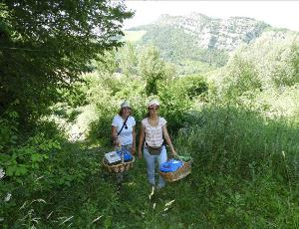
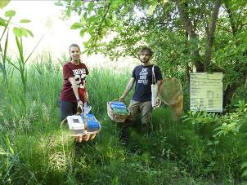
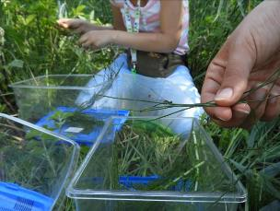
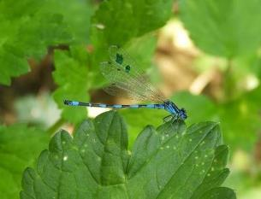
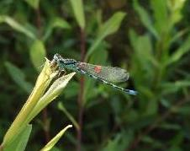
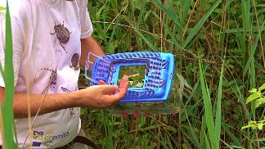
Action C5 - Translocation of Coenagrion mercuriale castellanii in the Romagna Macroarea

Slide 21
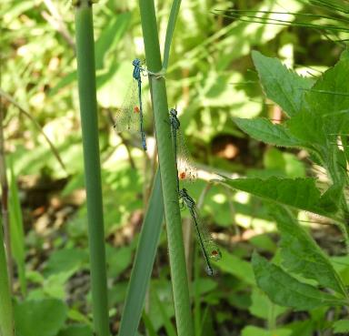
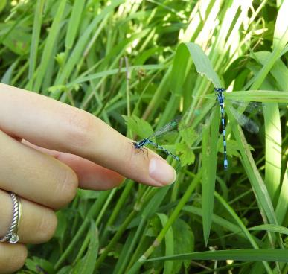
Action C5 - Translocation of Coenagrion mercuriale castellanii in the Romagna Macroarea
Moments of the release of adult specimens in the streams

Slide 22
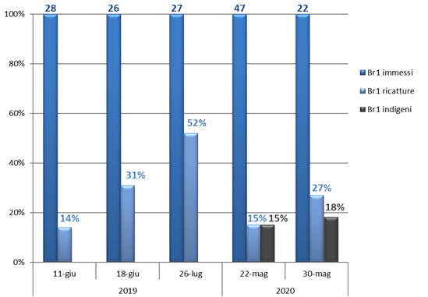
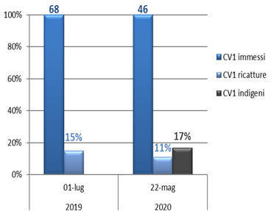
Action C5 - Translocation of Coenagrion mercuriale castellanii in the Romagna Macroarea
Number of individuals introduced (blue), percentage of recaptured (blue) and indigenous individuals (black) in Stream CV1 of Casola Valsenio in 2019 and 2020
Number of individuals introduced (blue), percentage of recaptured (blue) and indigenous individuals (black) in Stream Br1 in the municipality of Brisighella in 2019 and 2020

