Slide 1

Michele Bove (Ticino Park)
LIFE TICINO BIOSOURCE Project
The Lombard water meadows, wet meadows of multiple value:
biodiversity, climate change, healthiness of agricultural products.

Slide 2
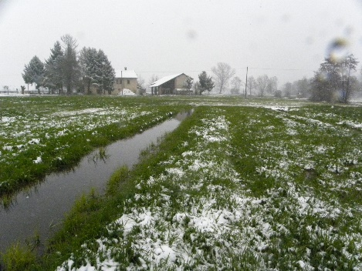
SEMINATURAL AGRICULTURAL ENVIRONMENTS
HISTORY, NATURE, PRODUCTS
STABLE MEADOWS ... WINTER
WATER IRRIGATION
BY FLOW

Slide 3
1188…first documents
1844 …Milan, as a queen among its riches,
sits among the meadows that crown her
and shows us the real type
of agriculture in the Lombard plain ...
"... especially admirable in the Milanese area is the use of water, since they use it all the time
in the summer for the meadows and other crops,
and in the winter for the water meadows ... "
1950… intensive agriculture 2020… 500 ha in the Parks

Slide 4
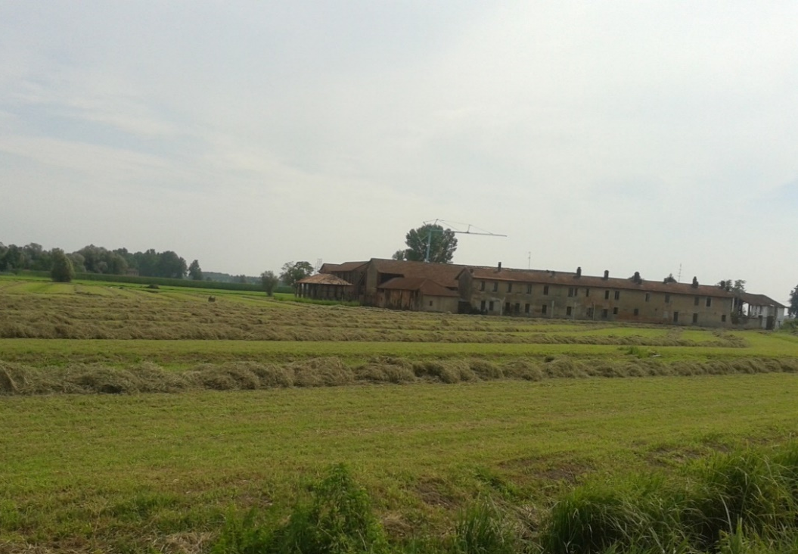
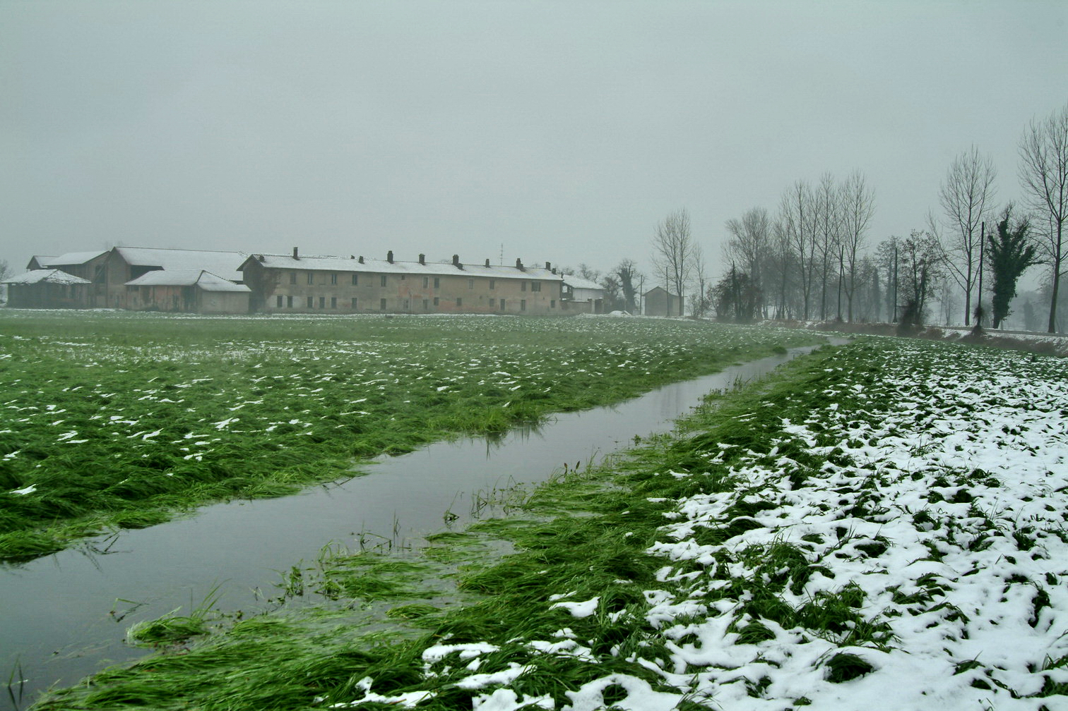
WHAT IS THE WATER MEADOW?
does it rot? no, it lives!
SUMMER…
…hay meadow
WINTER….
…water meadow for grass

Slide 5
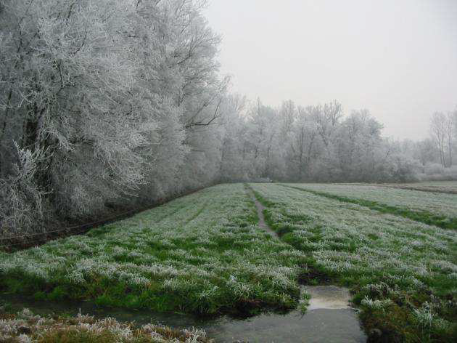
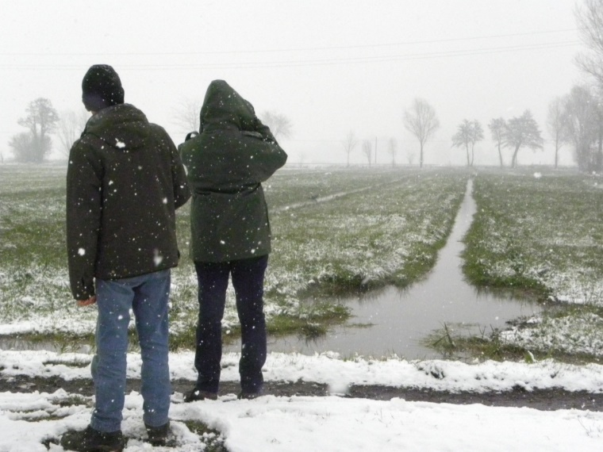
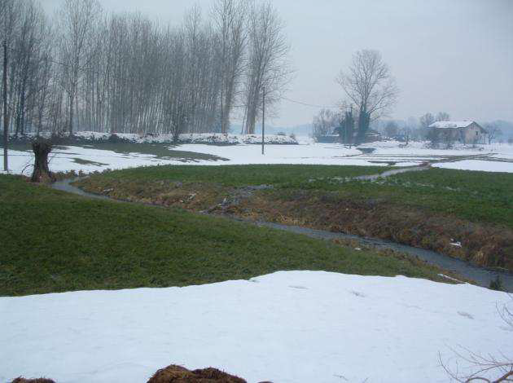
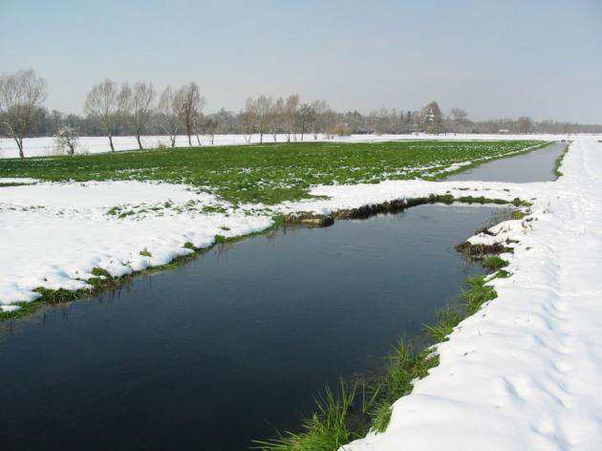
The "nival" miracle

Slide 6
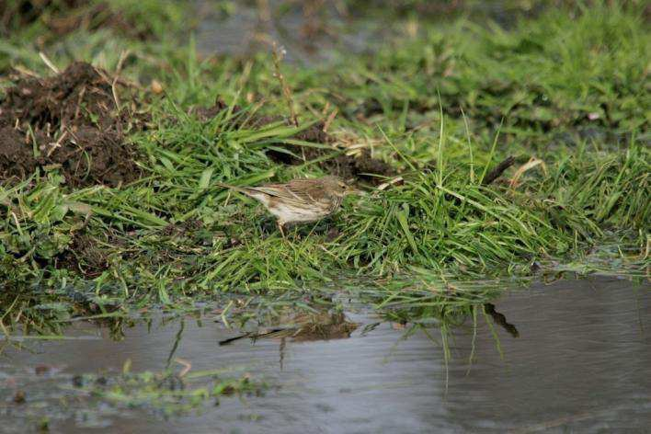
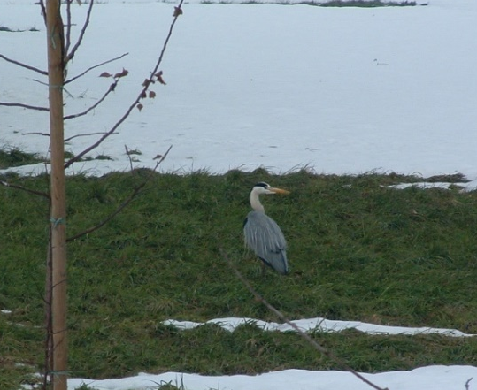
BIODIVERSITY
’’…islands of natural history …’’
UCCELLI
129 species
21 of EU interest 41 SPEC (Species of European Conservation Concern)
lapwing, linnet, pipit, tottavilla, woodlark, skylark, little egret, hen harrier,
(Fondazione Lombardia per l’Ambiente-Lombardy Foundation for the Environment)

Slide 7
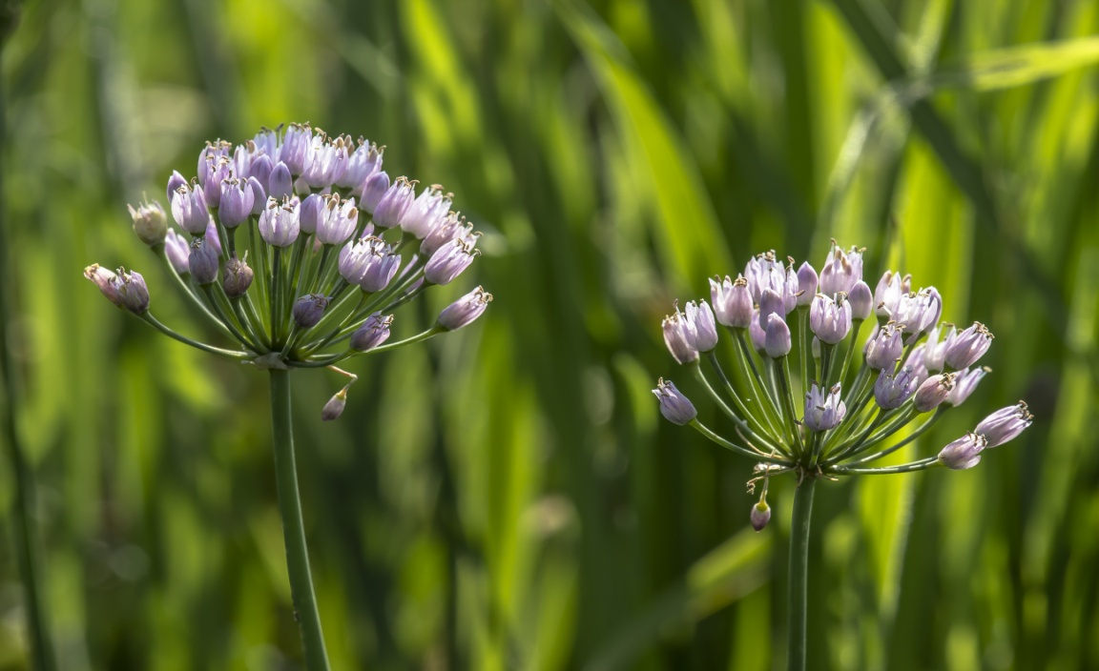
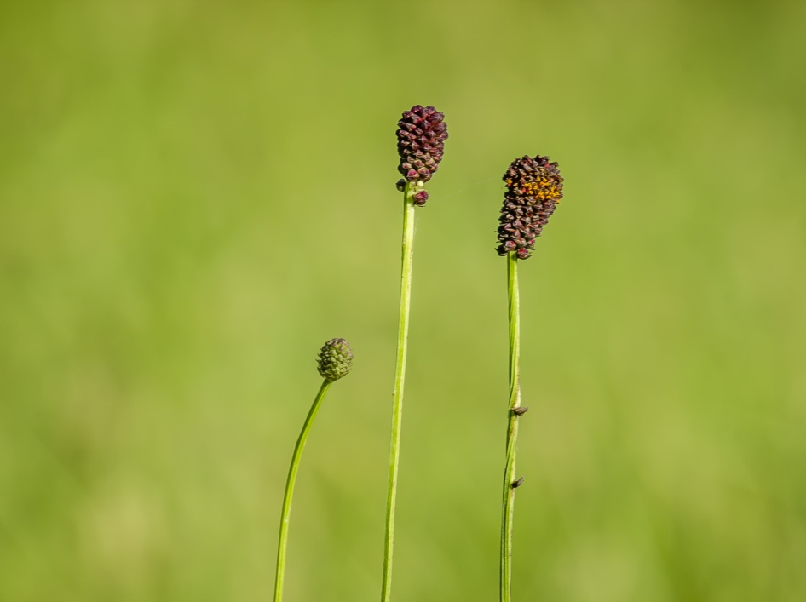
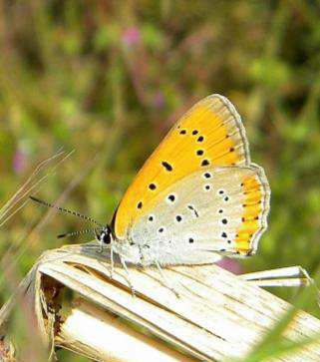
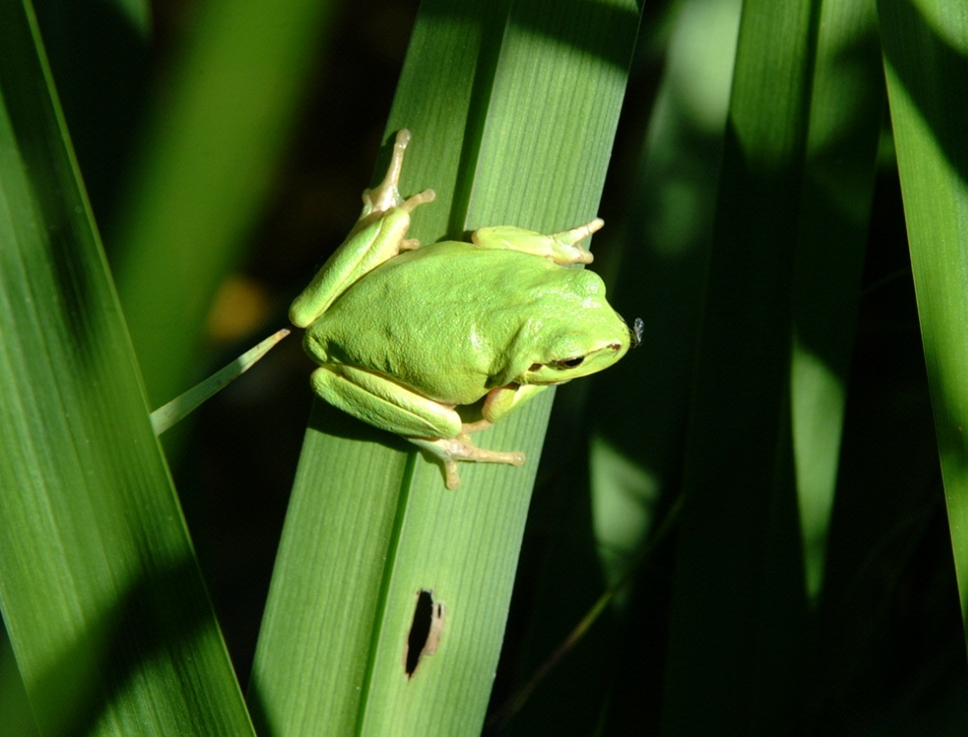
Allium angulosum
Sanguisorba officinalis
Licena delle paludi
…FLOWERS
BUTTERFLIES
FROGS,…
(Fondazione Lombardia
per l’Ambiente)
raganella rana di lataste

Slide 8
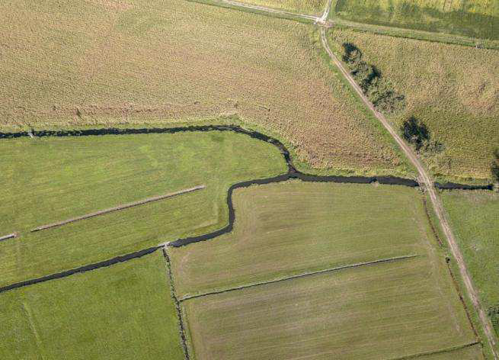
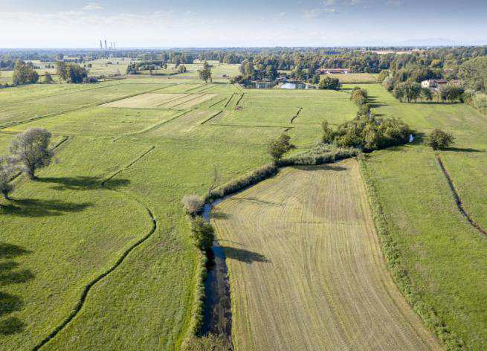
WATER MEADOW, PART OF A LANDSCAPE
complex irrigation network water, willows,
grass system
Registro Nazionale (National Register)
Paesaggi Rurali Storici (Historic Rural Landscapes)
Landscape Award of the Council of Europe (2019)

Slide 9
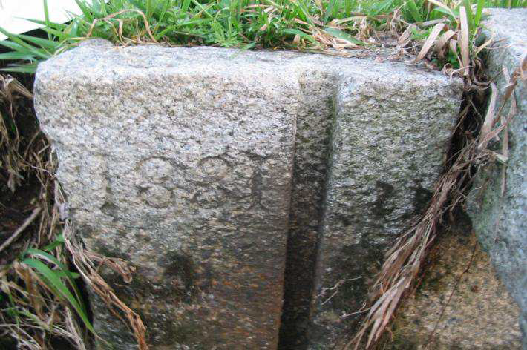
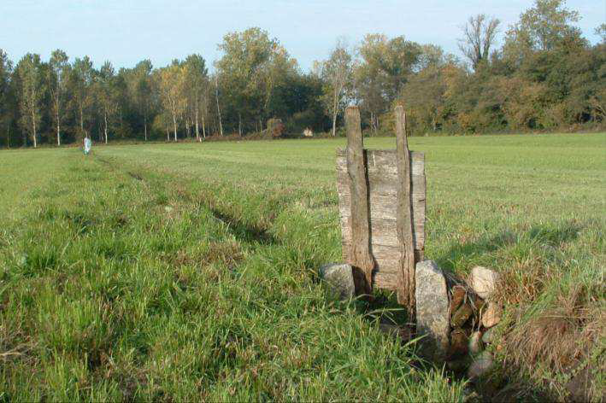
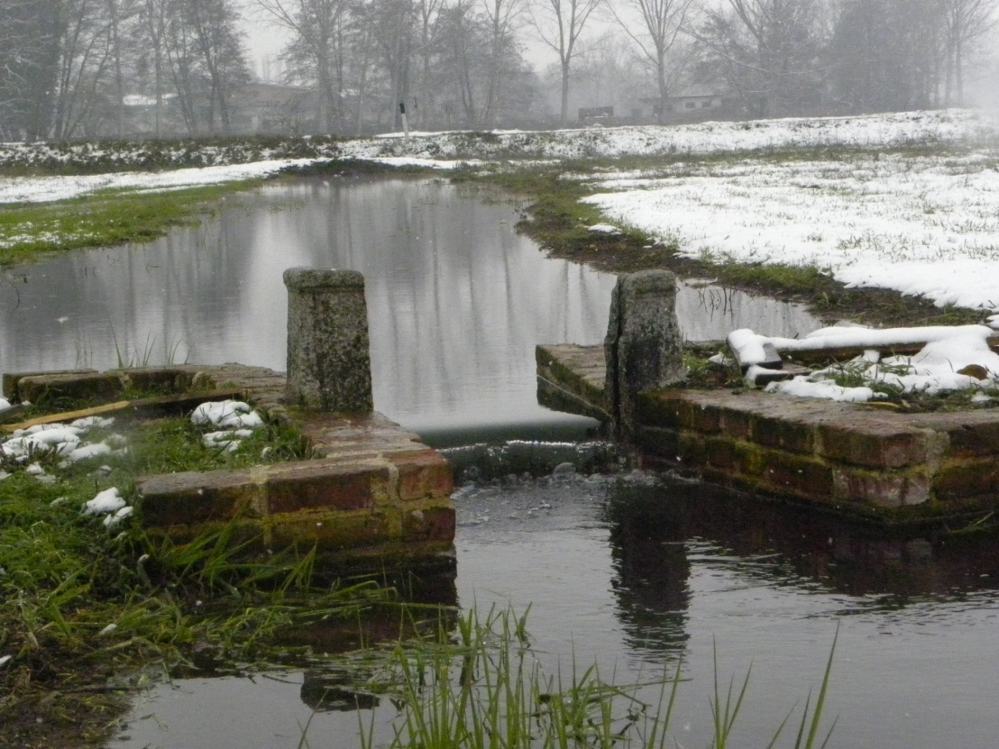
HISTORICAL Origins
irrigation artifacts
tangible heritage
(POLIMI LAB Parid)

Slide 10
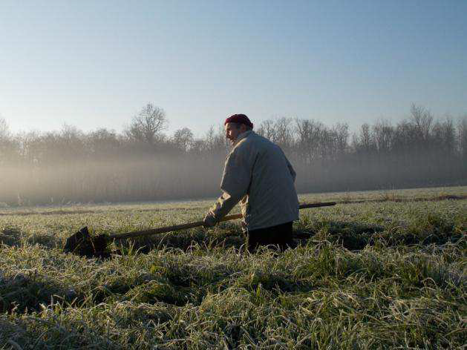
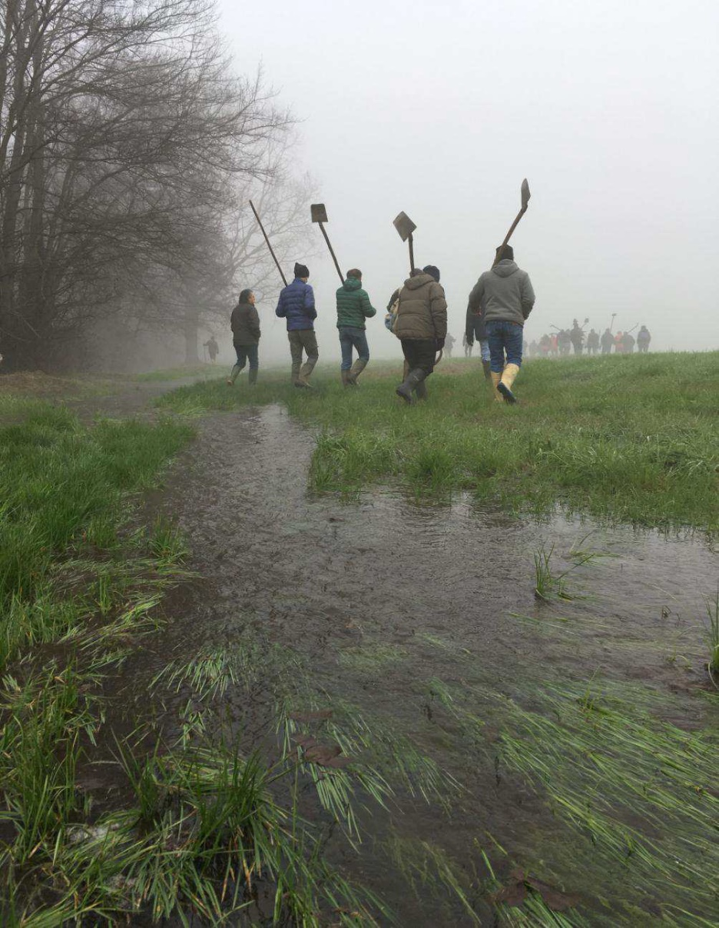
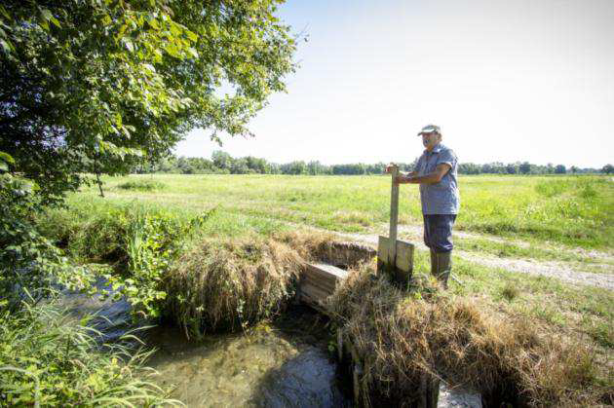
THE CAMPARO (field guard)
…tangible heritage
intangible heritage
formation of new campari (LIFE Biosurce)

Slide 11
WHY DID THEY DISAPPEAR? intensive agriculture
feeding cattle with unifeed… no green grass
larger companies, mechanization ... no manual skills
complex irrigation network ... operational difficulties
WHAT CAN WE DO?
Water Meadow Regulation (since 1988)… 300 ha…
60 companies
Recovery of abandoned water meadows (LIFE BIOSOURCE - 60 ha)
from the contributions of the Park to the RDP
(Rural Development Programme)
Rediscovery of meadow forage (UNITO, Disafa)

Slide 12
"While in the northern part of Europe,
we fail in our purpose
unless using roots and stimulating drinks,
and all this at great expense,
the Lombards get it effortlessly
and better than us with their water meadows "
(BURGER, 1843).

Slide 13
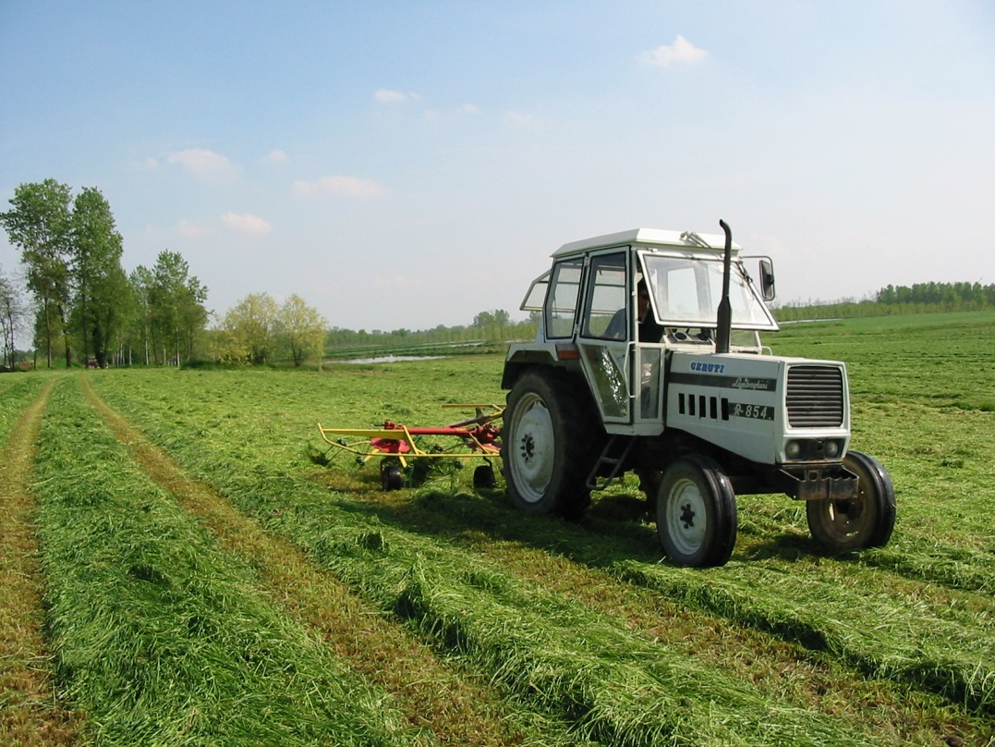
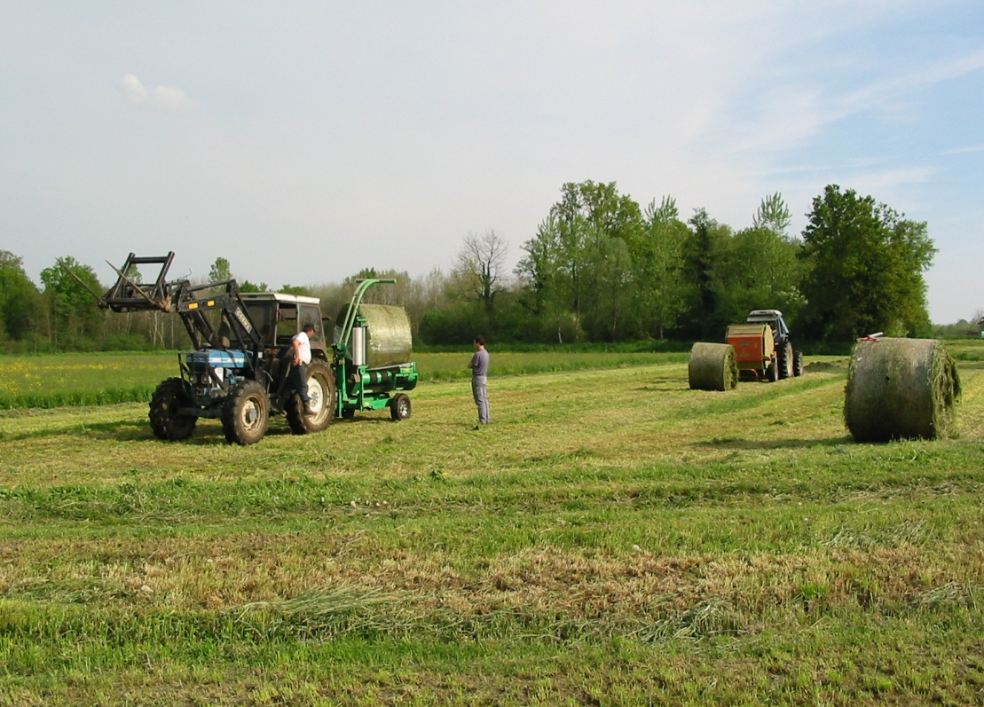
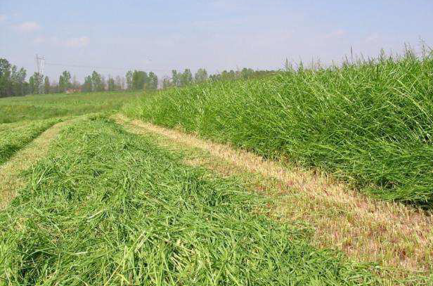
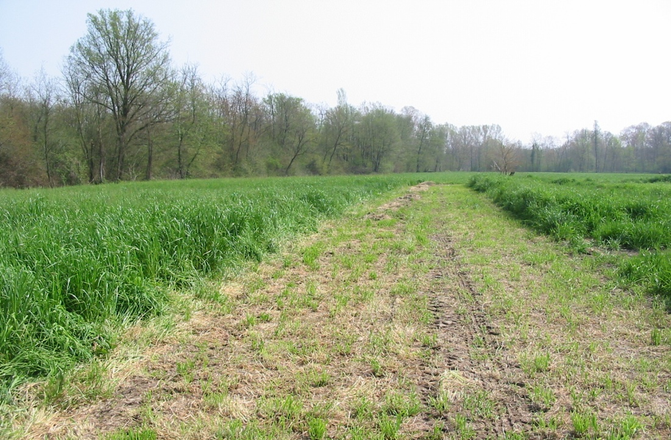
2 MORE CUTS IN THE WATER MEADOW

Slide 14
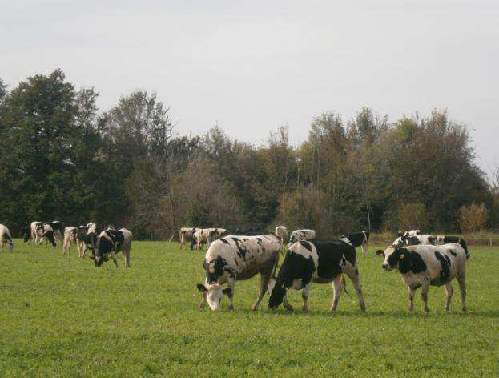
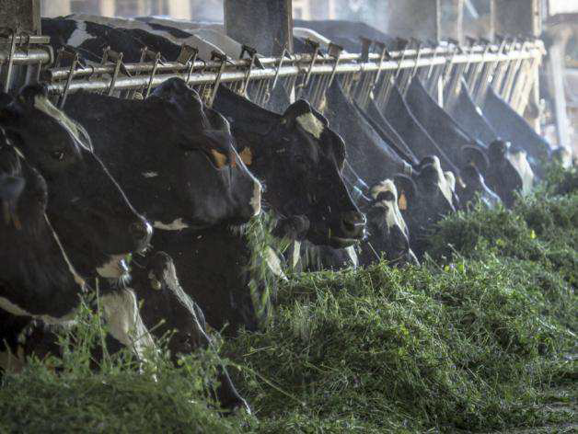
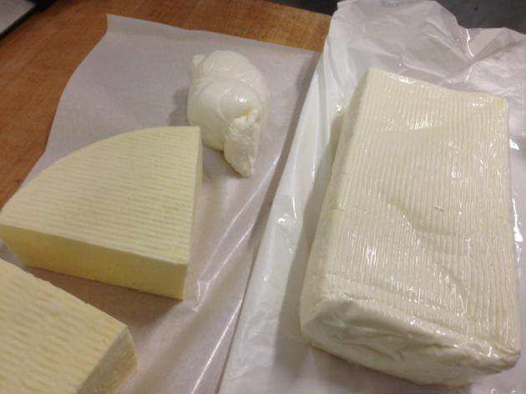
more green grass and meadow forage
less feed, less corn,
frequent mowing… more protein
more biodiversity, less chemistry
less CO2 in the air
more C in the soil
more self-sufficiency
less ration costs (UNITO DISAFA)
Yellow milk… like mountain milk… HEALTHIER MILK

