Slide 1

Business Growth Hub
Hilary Centeleghe
Growth and Start up lead

Slide 2
Agenda-
0845- 0900- Arrive/ Welcome
0900- 0910- Recap on yesterdays visits
0910- 0940- Growth and Start up team
0940- 1010- Recipe4Success
1010- 1015- Q&A
1015- 1030- Break
1030- 1130- The wider Business Growth Hub- what we do and why
1130- 1200- Q&A
1200- Close

Slide 3
Growth and Start up Service
Livelihood
Pre- Scale
Growth
Non growth (0-3 years)
0-3 years high growth
+3 years high growth
Start Smart program (People plus)
1-2-1 support
B2C (people plus only)and B2B
Recipe4Success
Spark2Scale
Tech program
Global Scale up
1-2-1 support
B2B only
Construction program
Global Scale up
1-2-1 support
B2B only
7 advisors
5 advisors
6 advisors

Slide 4
Growth and Start Service
Involved with/ contributing to-
Local Authorities (recharge, Awards, advisors)
Universities (UTC etc)
GMCA (Food Strategy, BREXIT)
DEFRA/ LEPs
Private providers (WeWork, Bwork, PWC, Banks, accountants, solicitors, web/ branding companies, service providers, Expos/ events)

Slide 5

Recipe4Success
Distinctive aspects of GM
Large number of F&D start up and Scale up businesses.
Strong independent local/ artisan presence across the region – typified by the ever growing Northern Quarter.
Large F&D producers (Kellogg's, Warburton’s, Park Cakes, Kingsland wines).
Strong logistics chain- Manchester Airport, Ship canal, Trafford park).
High proportion of Universities- large student population (influencing the F&D scene).

Slide 6
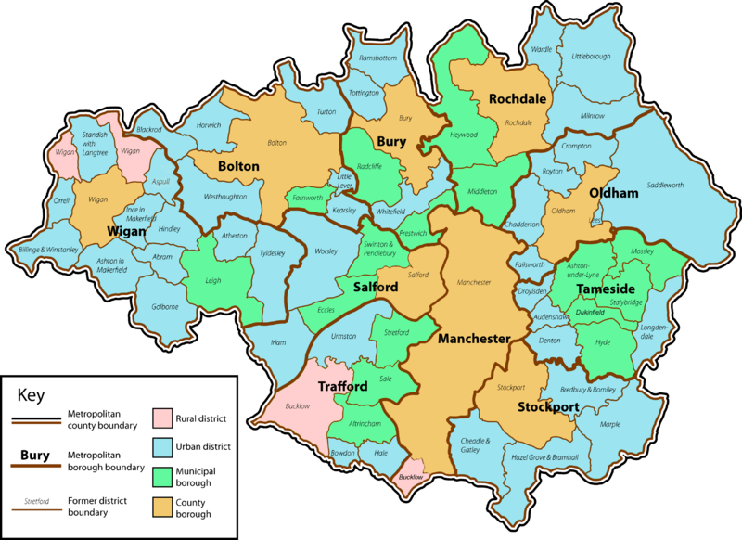
Rural areas

Slide 7
Safe and Legal
Online presence
Strategy
Selling your product
Recipe 4 Success 2019
An audience with Morrisons
Branding
Meet the Buyer X2
Launch
Exporting
Pitching to a buyer
January-March 2019

Slide 8
Didsbury Gin (Dragons Den, national, export)
Se7en brothers & Sis4ers Gin (national, export, new pub chain)
Soop (Selfridges, Morrisons, Good food awards).
Fazila Foods (attained BRC then bought out by Spar)
Past successes…
MTB- Tesco, Morrisons, Holiday Inn, Pub groups, regional food service companies
Howdah snacks (Morrisons, Dragon Den)
Just Bee (National, Dragons Den, Give it a year))
Zymurgorium!
First Chop- DEFRA new exporter of the year
100+ companies (2015-18)
44 companies (2019)

Slide 9
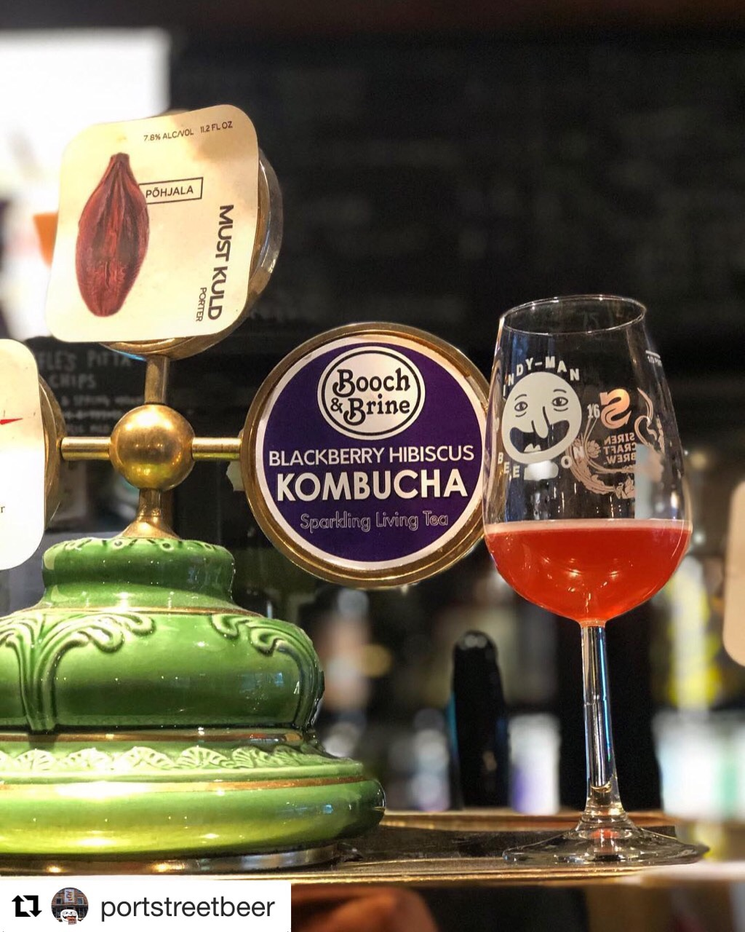



…and from this years cohort.
Booch and brew- RDPE grant and new Kombucha brewery (new accounts)
Amal Cowan- Bas Bas (1m)
Zymurgorium (£6K-£8m in 3 years)
First chop brewery (Defra exporter of the year 2017)
Vegan food business (on Tuesday) and Caribbean drink ( 3 weeks ago). Airs this summer.
Brew Loka- 12 new accounts
Notes:
MH Link to Amal – 4-5m then 25m40s -26m40s

Slide 10
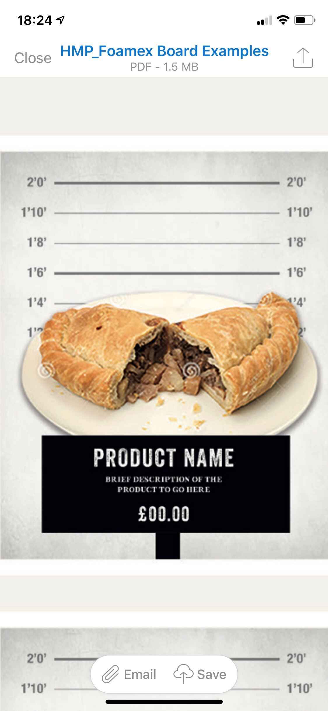

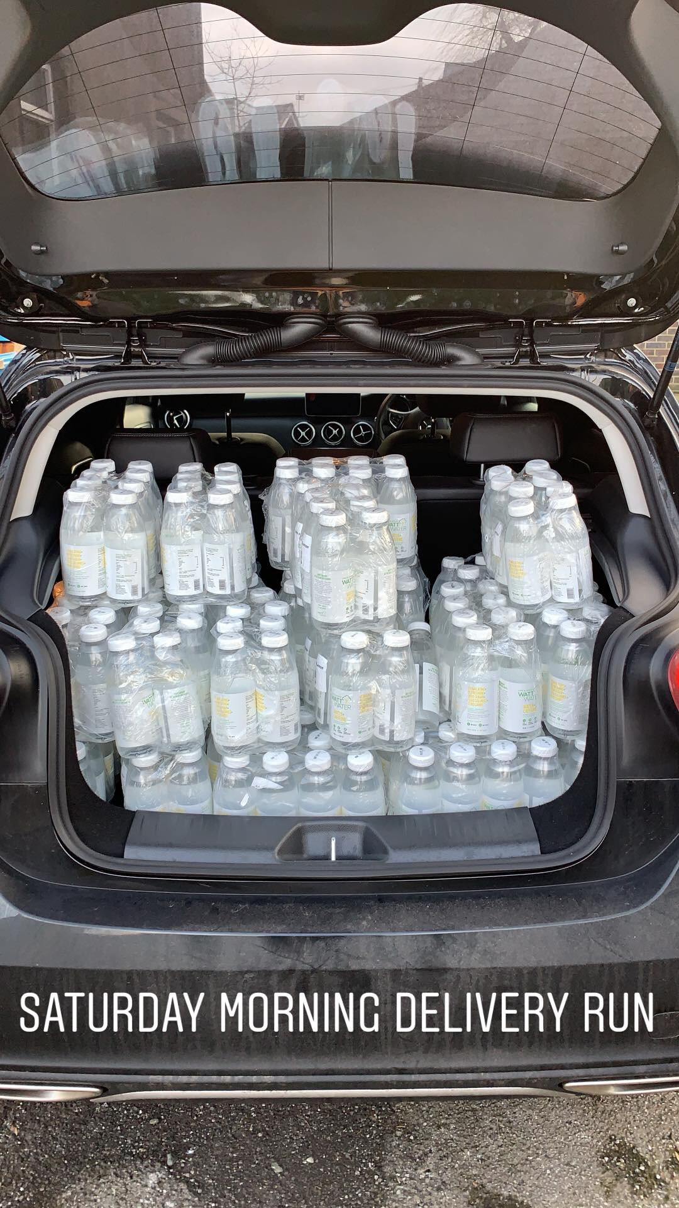
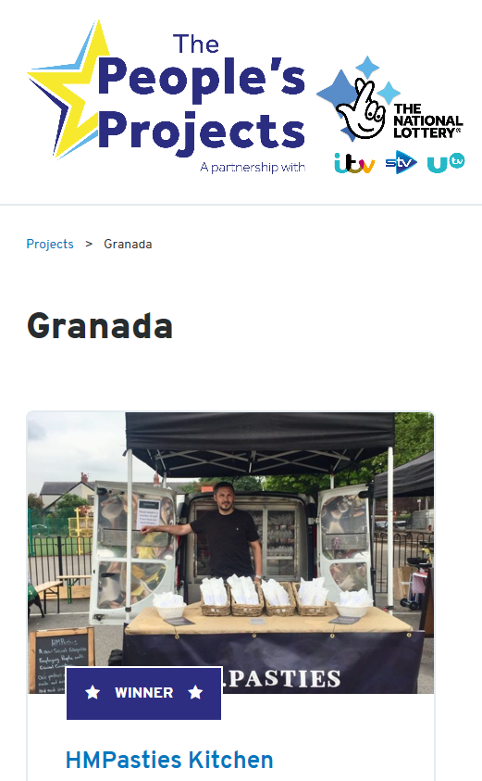

A few more successes…with the ongoing cohort!
HM Pasties- employ ex-offenders. Supplying to football club. Appeared on the One show, ITV, BBC. Fits with Mayoral social responsibility.
Watt Water- University accounts New to market product!
Notes:
MH

Slide 11


Group &1-2-1 business support by specialist F&D advisors.
We source the commercial opportunities (Tesco etc)
Triple helix approach- Hub/ L.As, Universities, private sector.
The SMEs drive future program development!
The buyers tell us what they want from a supplier.
Why is it a success?
Brings together the F&D SME community- very powerful
Follow on support for Scale up businesses.
Companies
benefit from the wider growth hub offer- finance, digital, manufacturing, export.

Slide 12

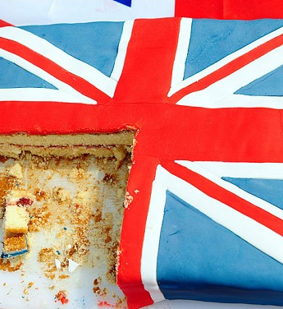
Last years Recipe 4 Success…
Recipe 4 Success 2018
A short video… 2m 55s

Slide 13
Q&A?
Notes:
MH

Slide 14
Break
Notes:
MH

Slide 15
The full Business Growth Hub (Specialist) service teams
Growth and Start up
People, skills & talent
Manufacturing
Low Carbon & resource efficiency
DCT & digital
Innovation
Access to Finance

Slide 16
Resource efficiency- Claire Scott
Notes:
MH

Slide 17
What is Resource Efficiency?
We help businesses increase profits by being more resource efficient to reduce operating costs and environmental impact.
Typical support includes:
Site visit to understand business and identify opportunities.
Written report of opportunities to reduce waste, utilities, materials & packaging use.
Ongoing support to implement opportunities / develop & demonstrate green credentials:
  Site meetings & guidance
  Research e.g. technologies & finding suppliers.
  Access to consultancy bank of technical specialists e.g. packaging eco design.
  Access to energy data loggers, compressed air leak detection, thermal imaging.
Workshops and events.
Green Growth Pledge – online pledge.
Green Intelligence – fortnightly e-newsletter.

Slide 18
Benefits and drivers for a business
What’s in it for the business?
Help to drive long-term efficiency:
  Cost Savings (profitability), Quantifiable Environmental Improvements
  Deliver against CSR targets and environmental KPIs
Development of meaningful green credentials:
  Improve tendering prospects & Win New Clients
  Shift brand perception = Customer & Staff Loyalty, New Marketing Strategies
Keep up to date with the latest research, technology, legislation and best practice:
  Reduced Risk of prosecution, being out-competed / left behind

Slide 19
Hilary Centeleghe

Slide 20
The full Business Growth Hub (Specialist) service teams
Growth and Start up
People, skills & talent
Manufacturing
Low Carbon & resource efficiency
DCT & digital
Innovation
Access to Finance

Slide 21
Q&A?
Thank you
Notes:
MH

